Slide 1
How to restart the project

Slide 2
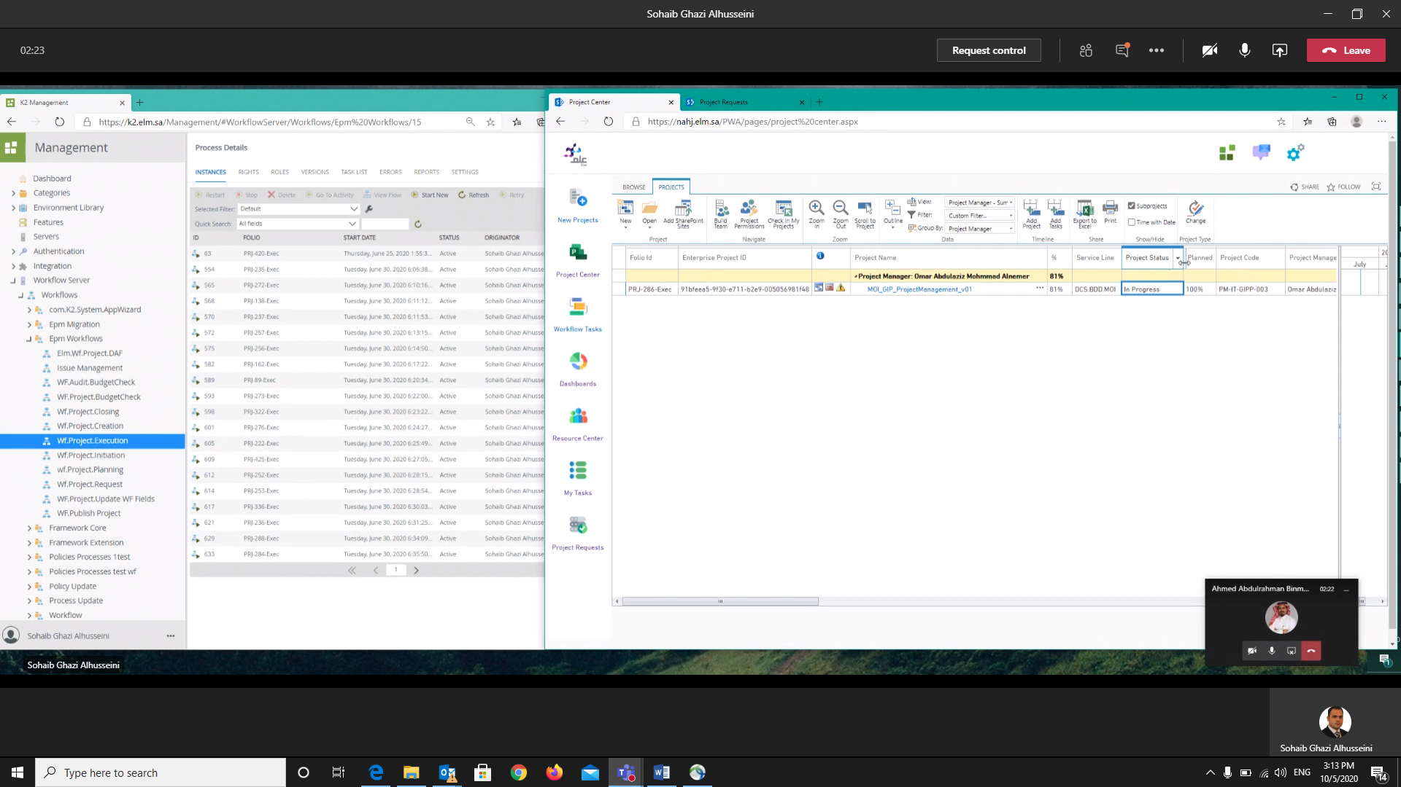

Slide 3
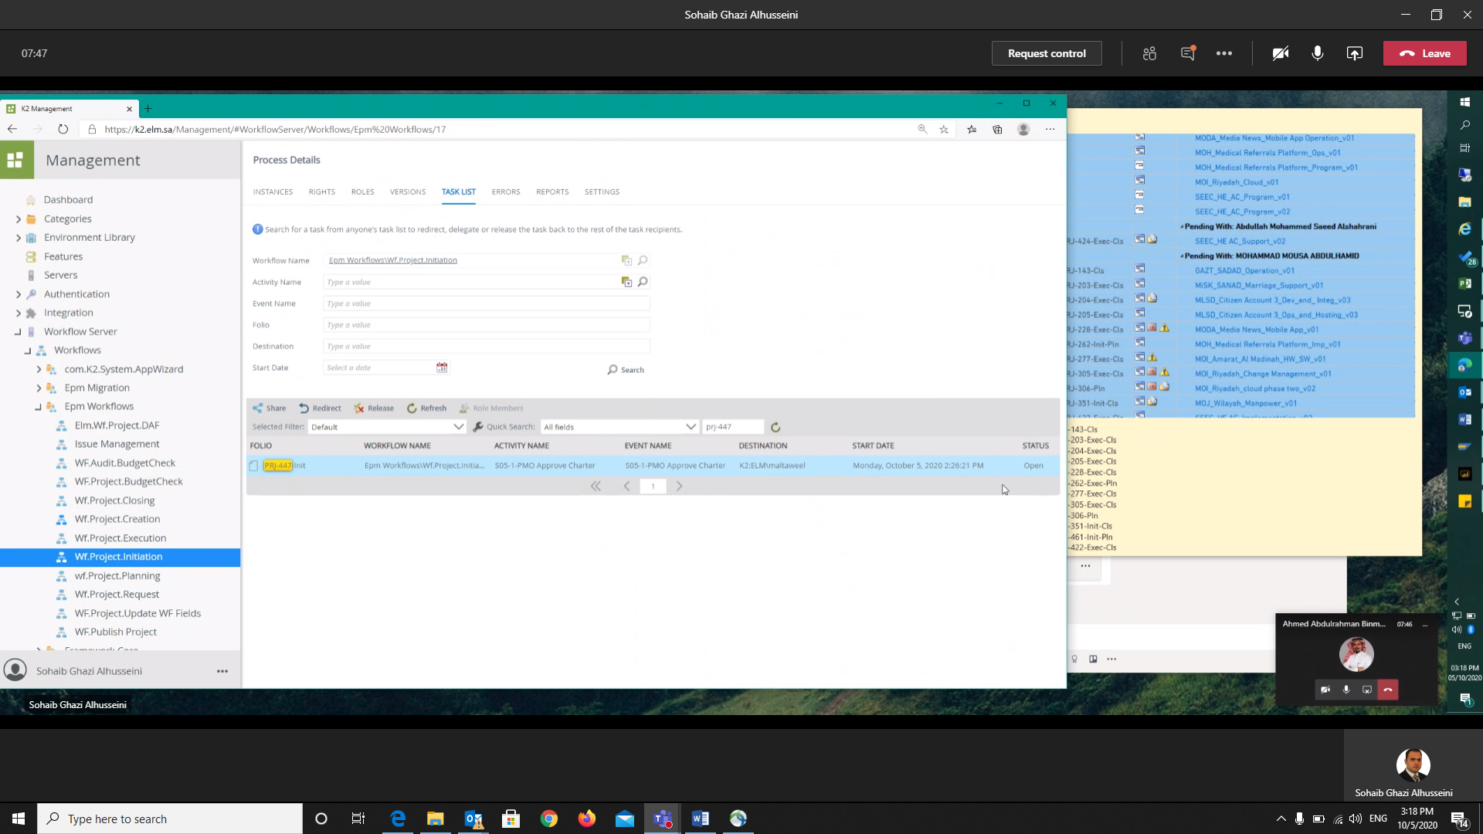
Here To know the destination
1
2

Slide 4
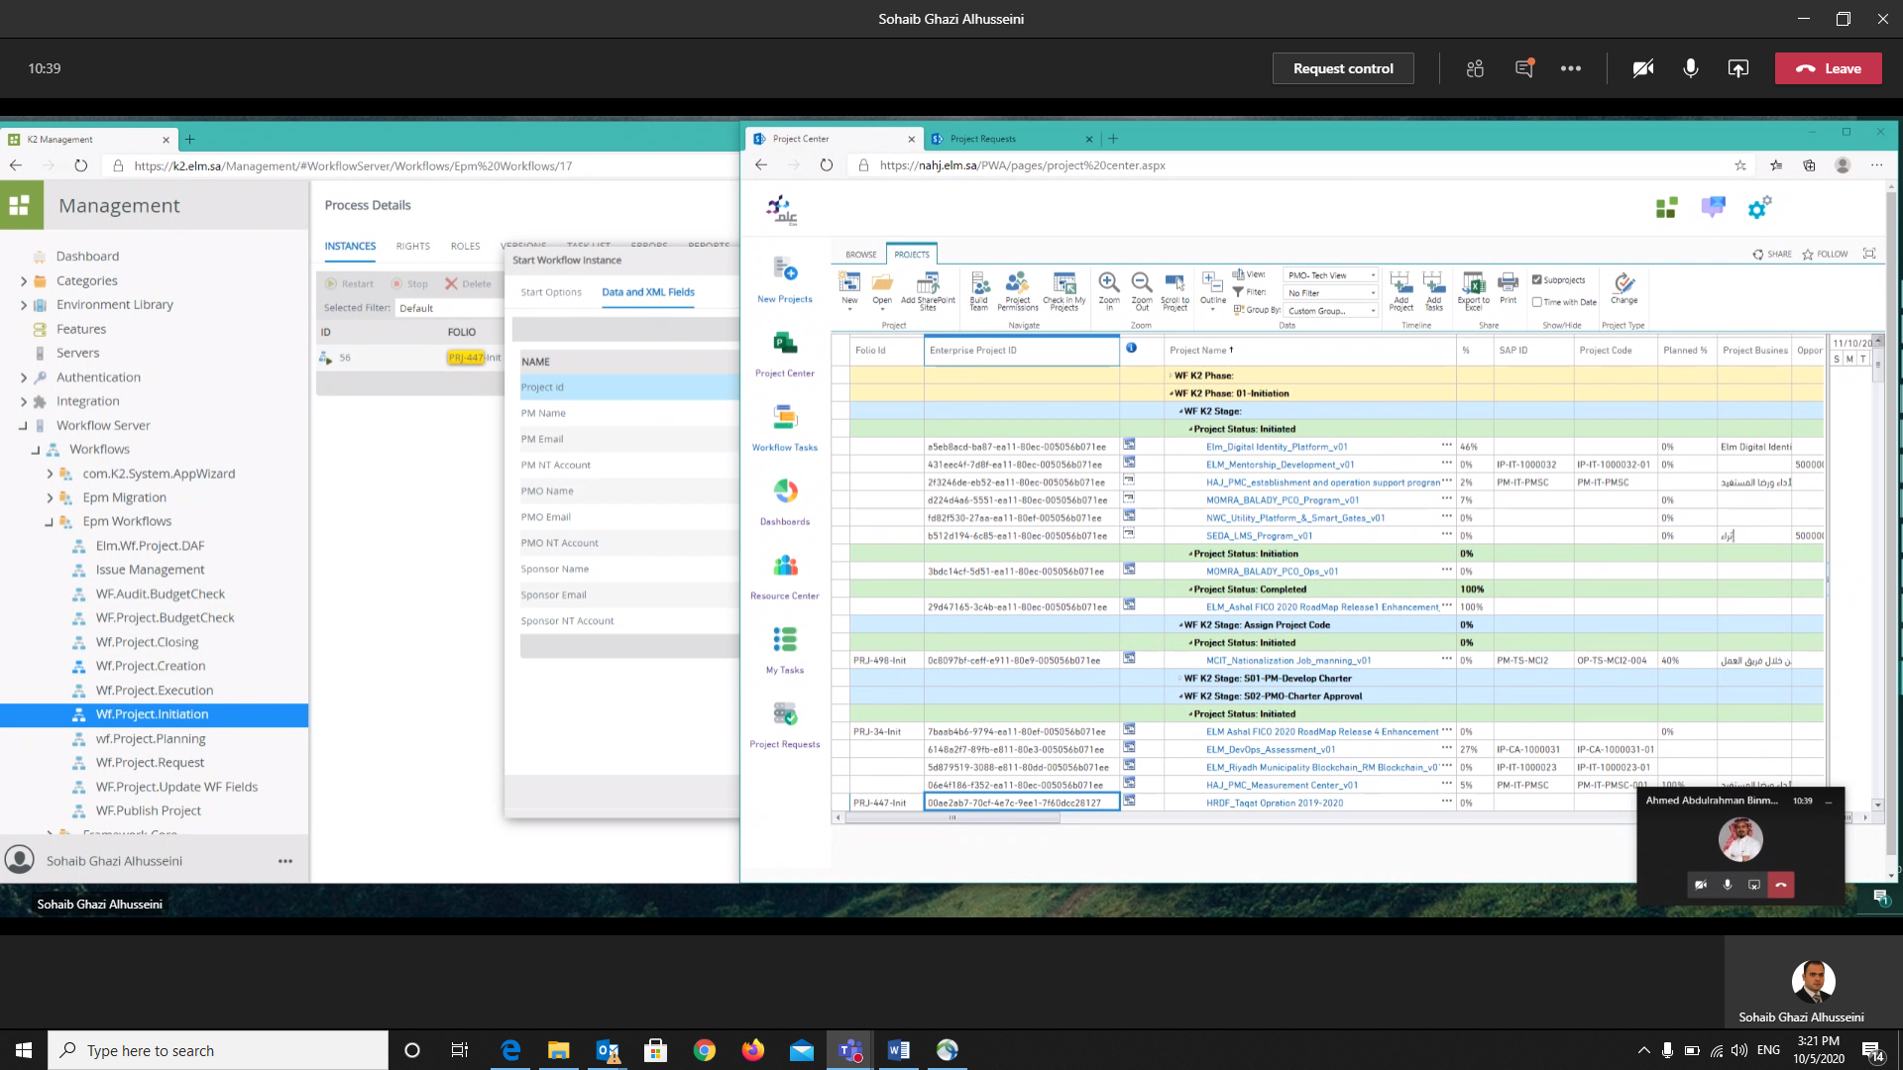
Here to find the Project ID

Slide 5
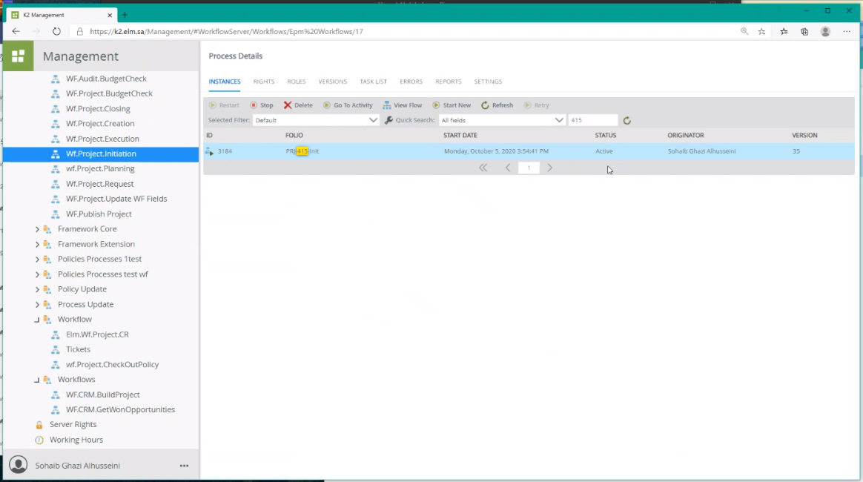
Then you have to “Start New”
You have to search

Slide 6
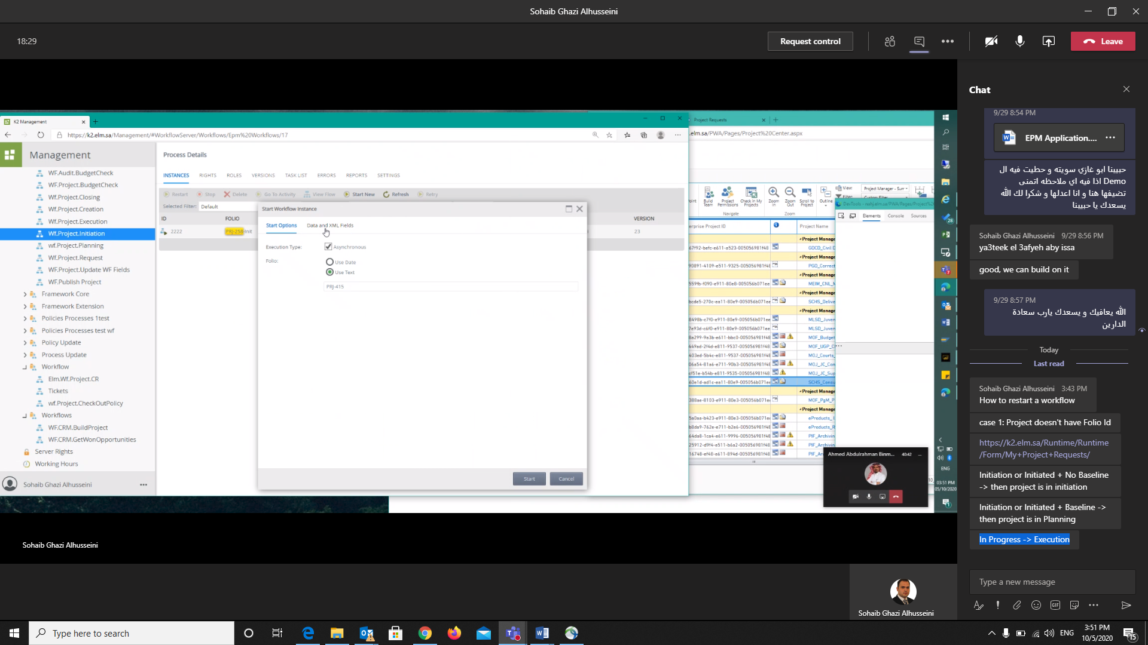

Slide 7
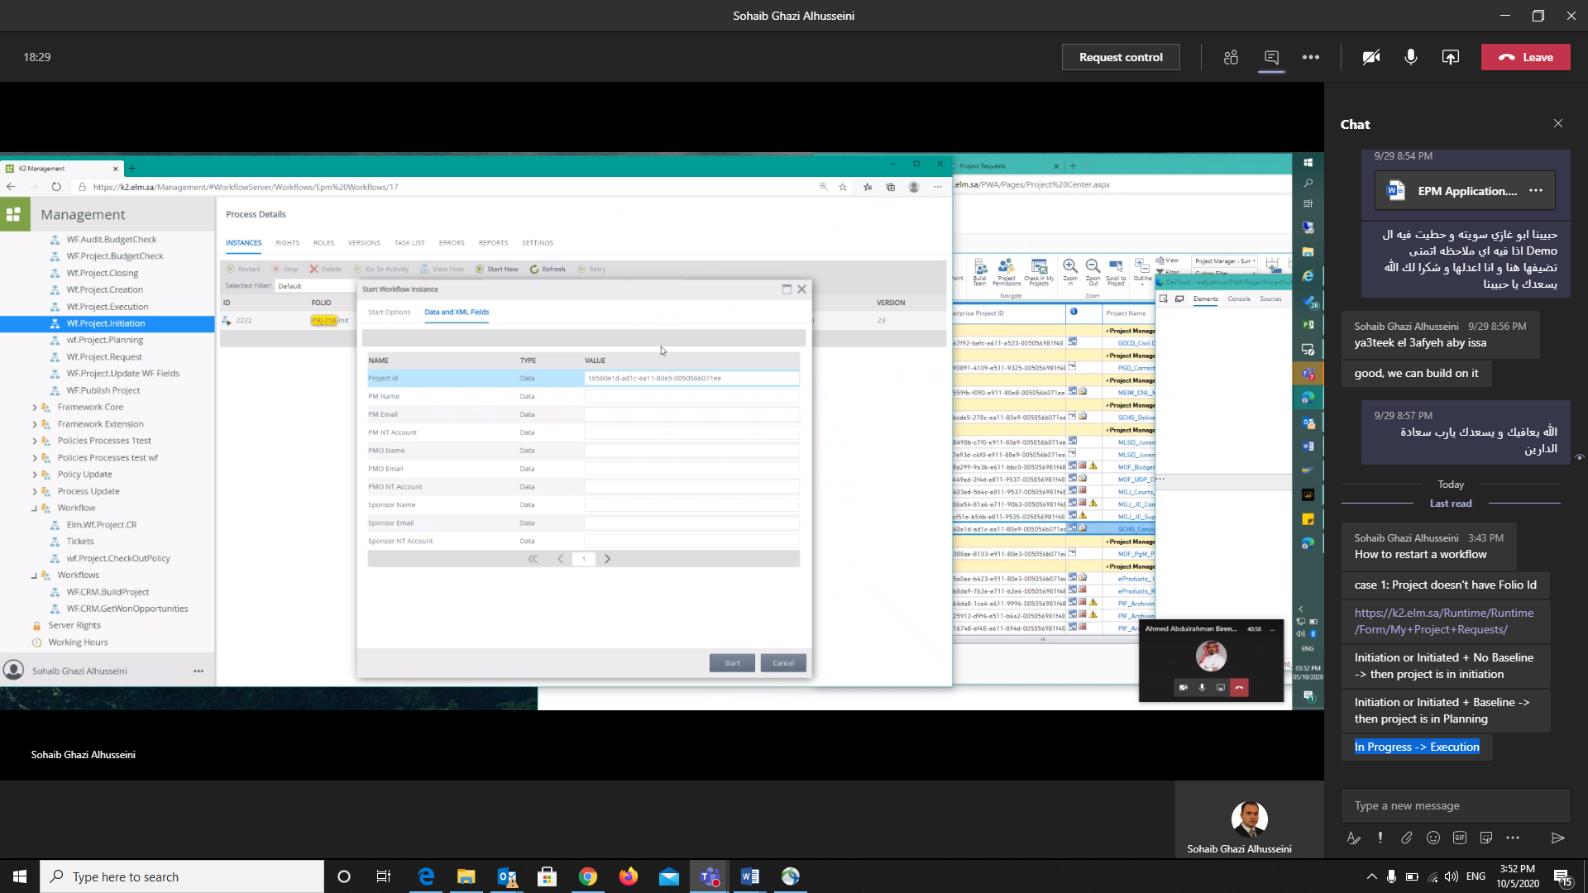
You have to copy the project Id from project center number and paste it here

Slide 8
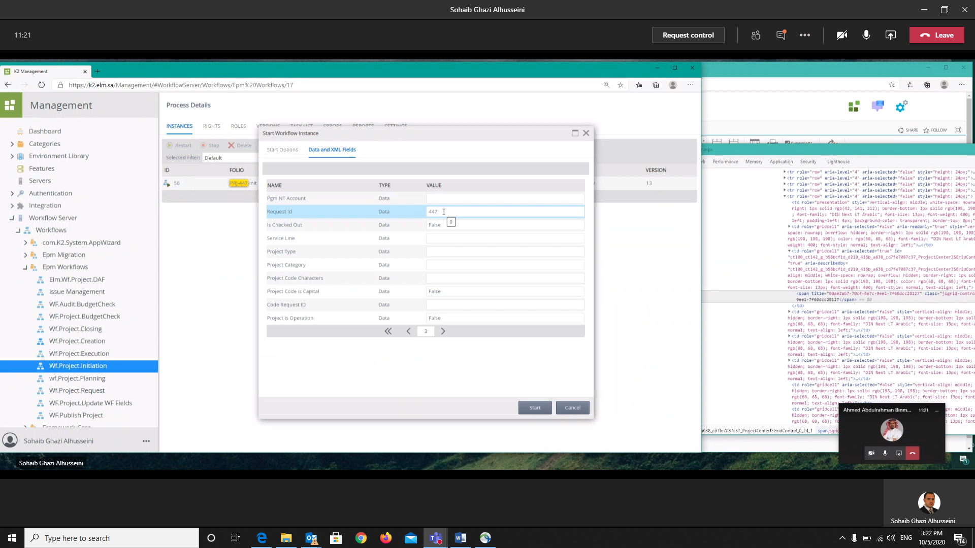

Slide 9
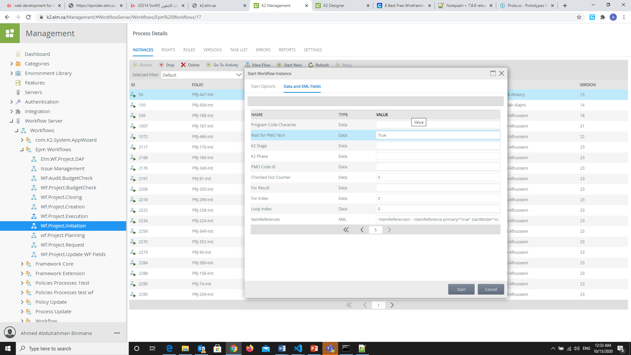

Slide 10
How to Restart a workflow without Folio Id

Slide 11
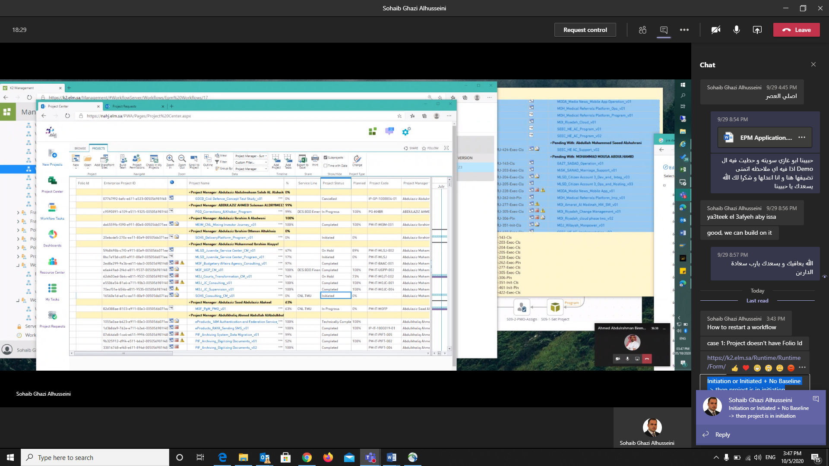
case 1: Project doesn't have Folio Id

Slide 12
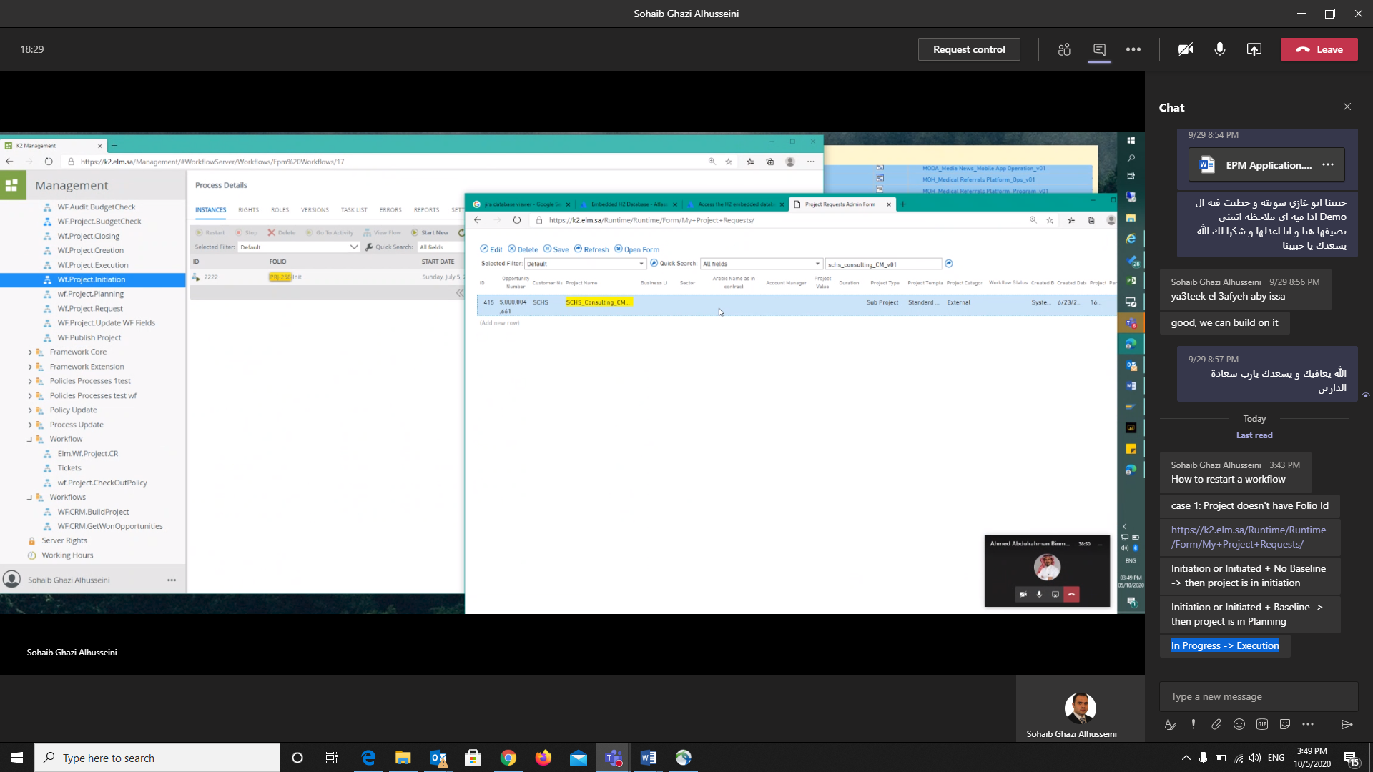
You have to get ID from the link below.
https://k2.elm.sa/Runtime/Runtime/Form/My+Project+Requests/

Slide 15
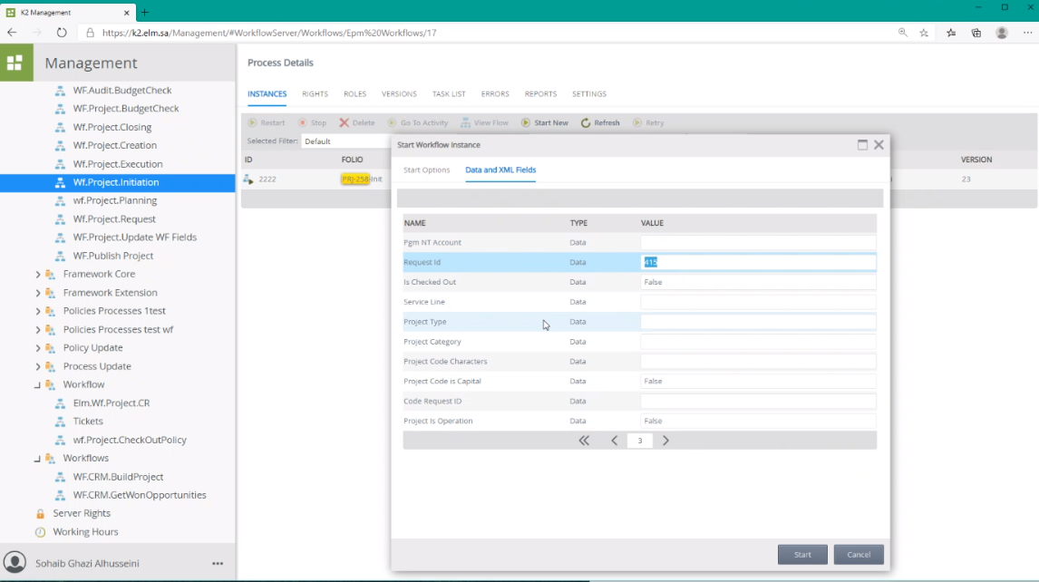

Slide 16
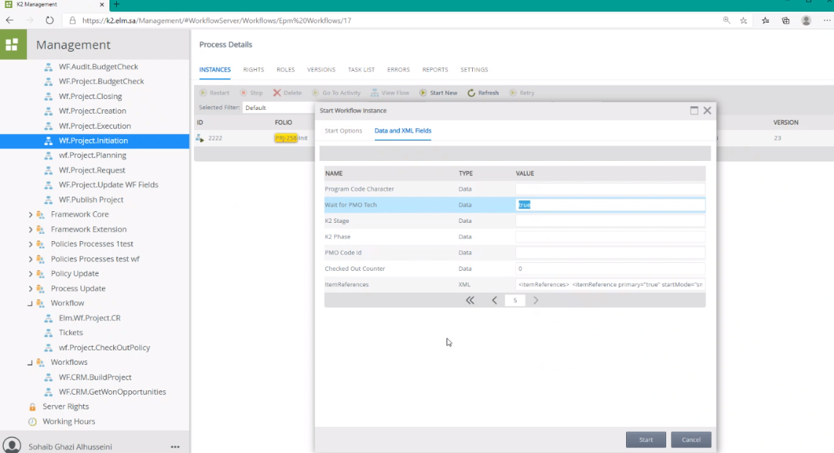

Slide 17
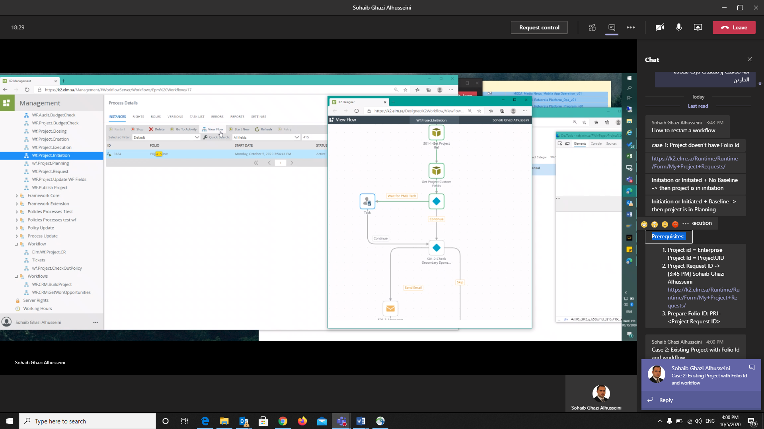

Slide 18
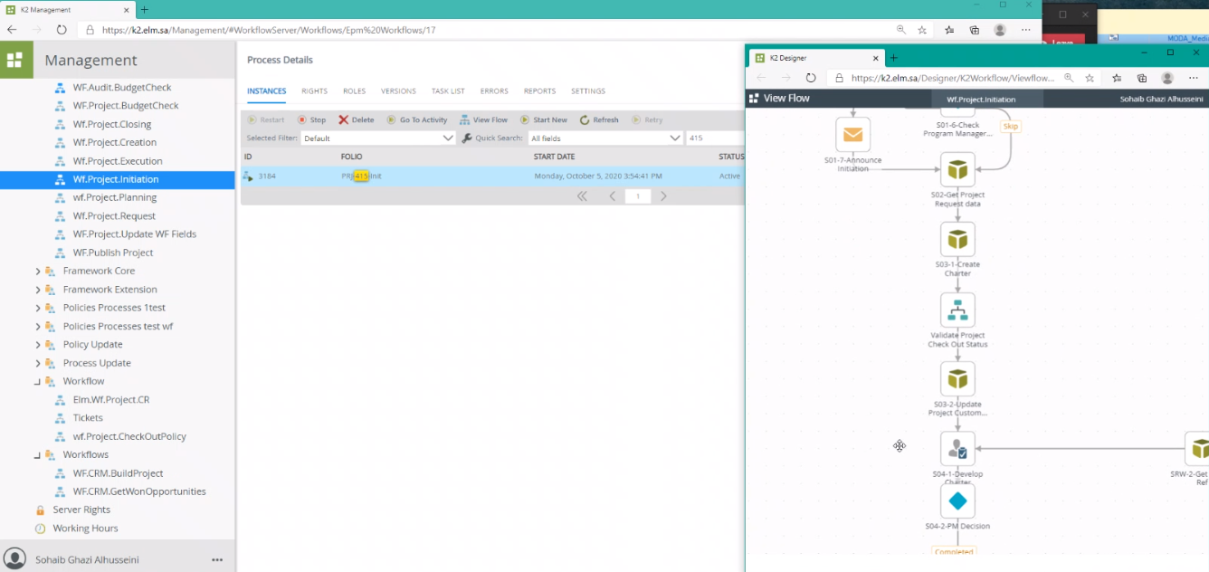
Target: Stage S04-1-Develop Charter

Slide 19
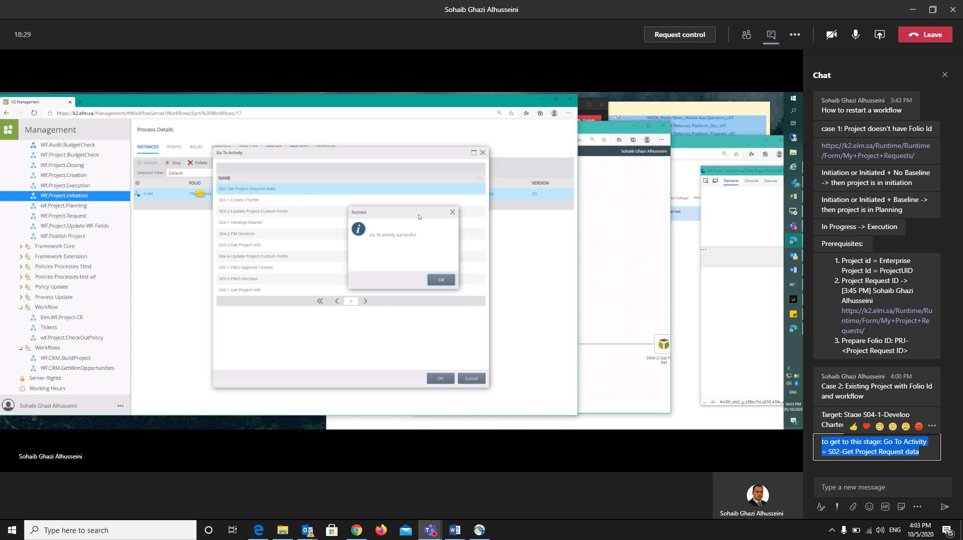

Slide 20
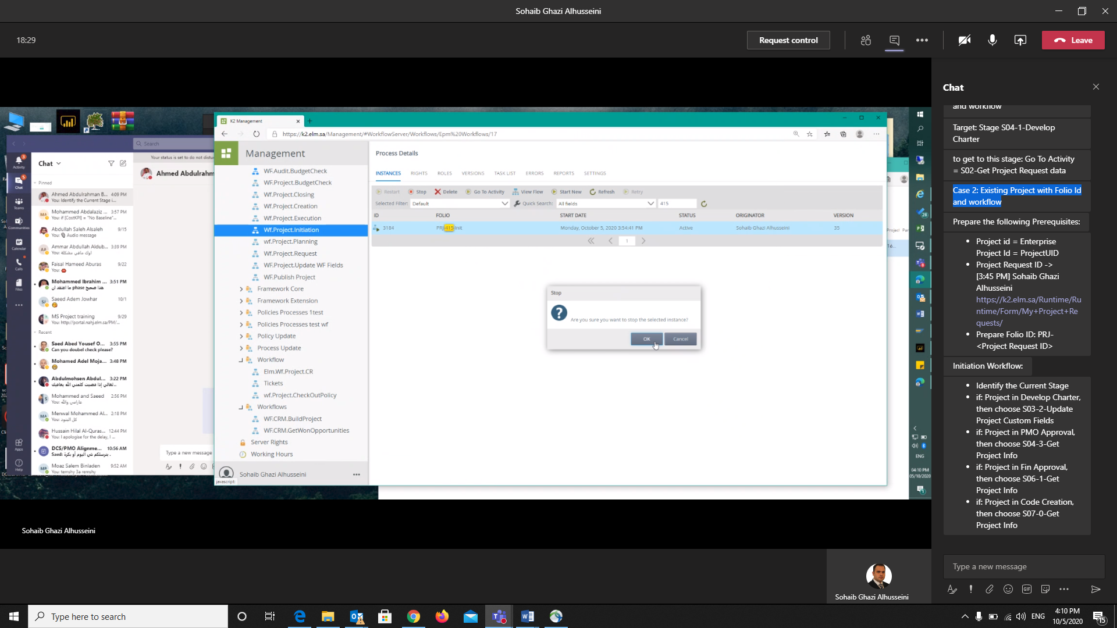
Case 2: Existing Project with Folio Id and workflow
· Project id = Enterprise Project Id = ProjectUID
· Project Request ID ->
https://k2.elm.sa/Runtime/Runtime/Form/My+Project+Requests/
· Prepare Folio ID: PRJ-<Project Request ID>

Slide 21
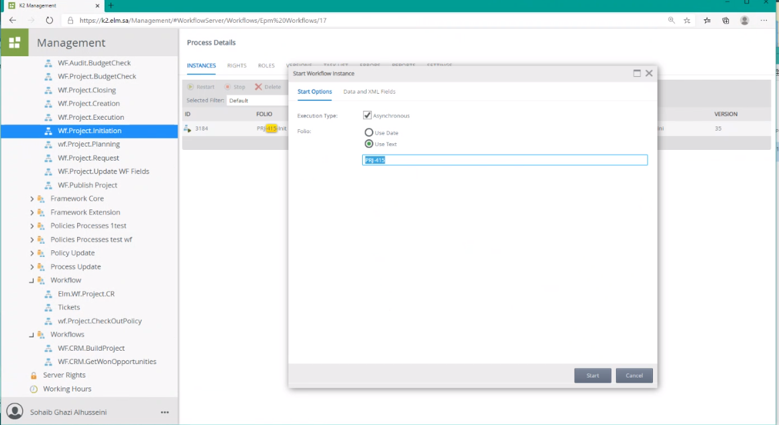

Slide 22
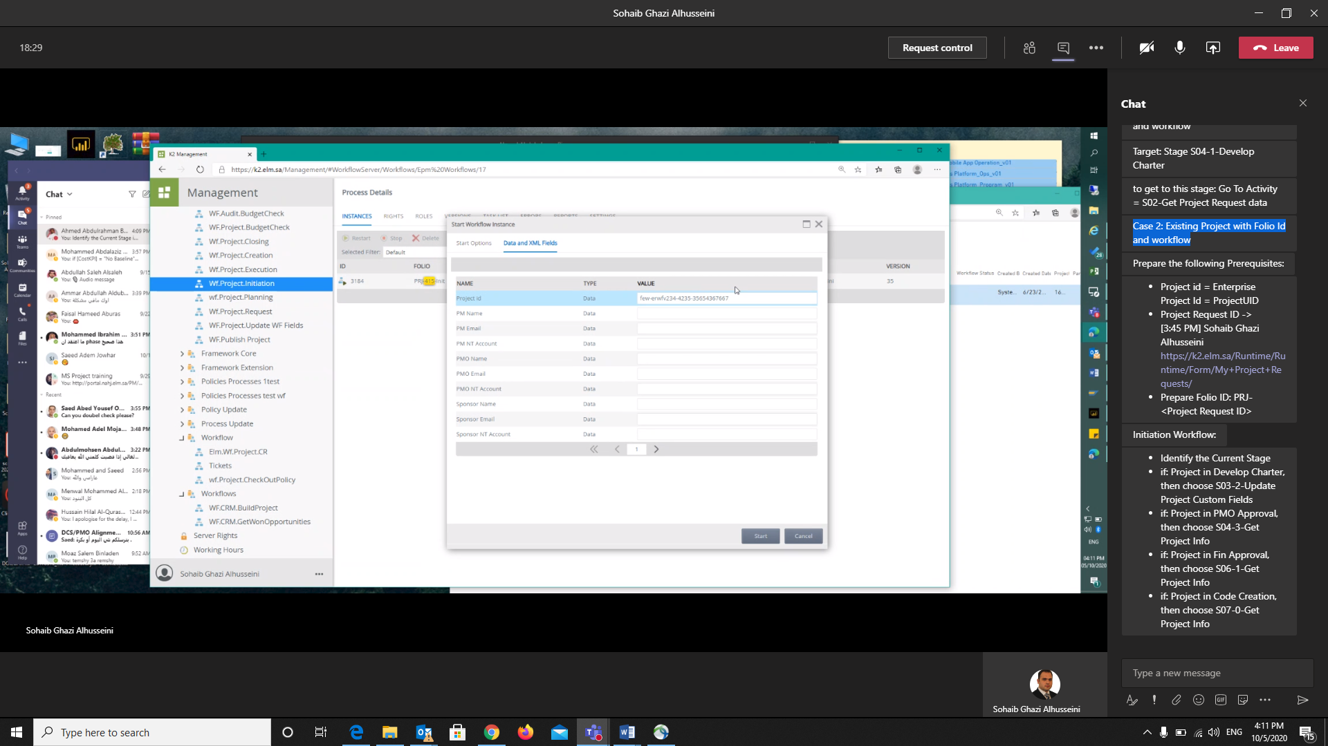

Slide 23
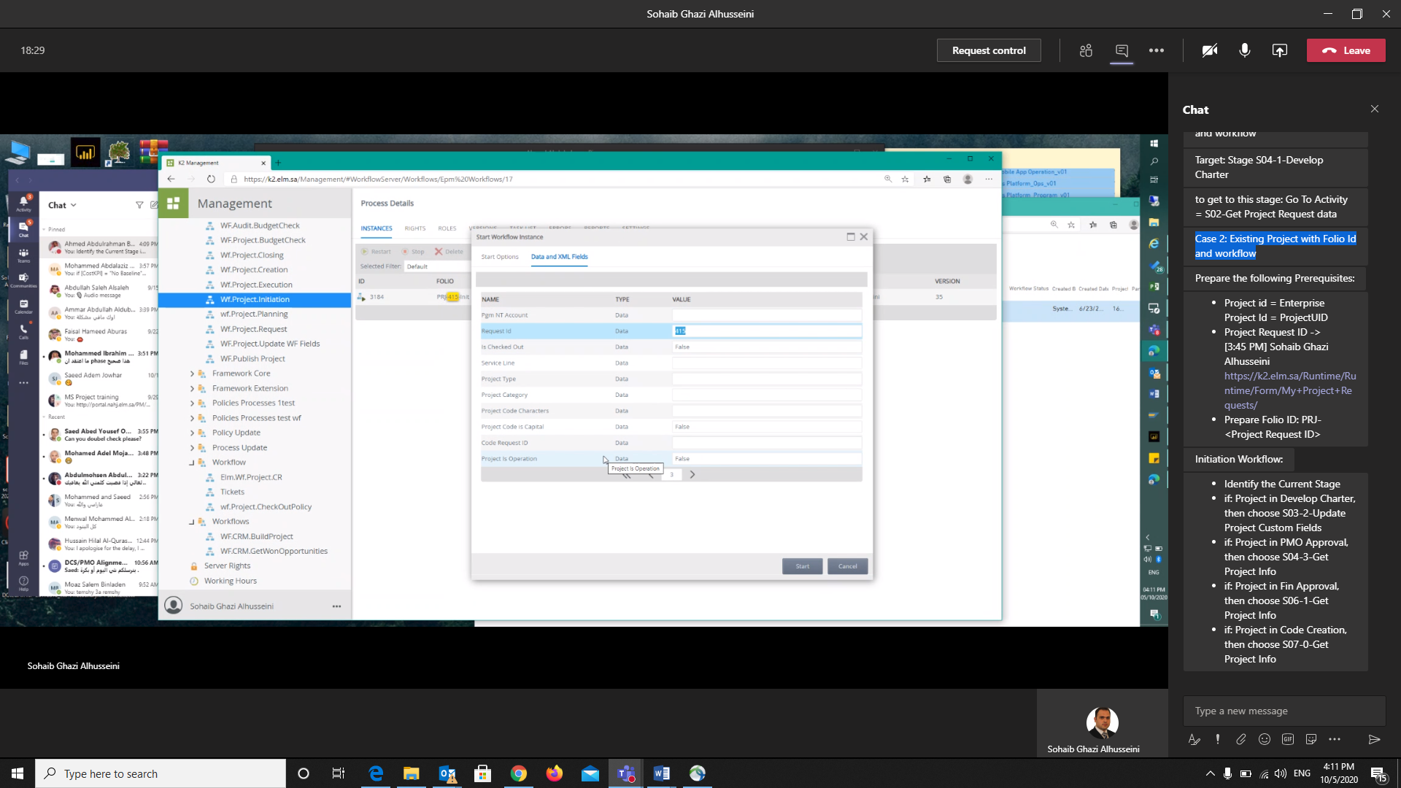

Slide 24


Slide 26


Slide 27
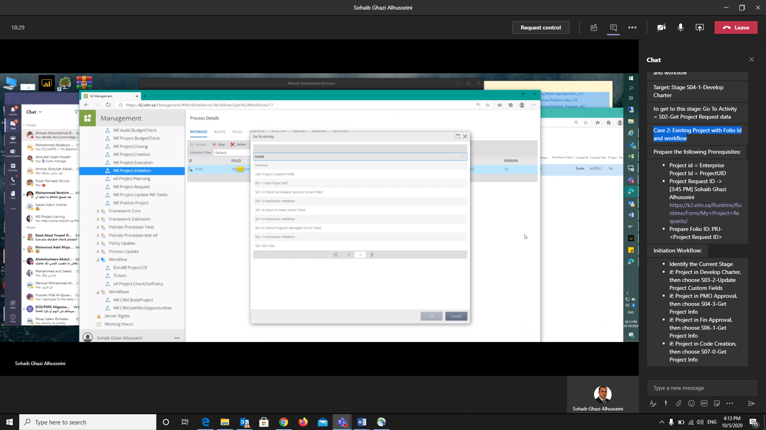
Initiation Workflow:
· Identify the Current Stage
· If Project in Develop Charter, then choose S03-2-Update Project Custom Fields
· If Project in PMO Approval, then choose S04-3-Get Project Info
· If Project in Fin Approval, then choose S06-1-Get Project Info
· If Project in Code Creation, then choose S07-0-Get Project Info

Slide 28
To Update Workflow

Slide 29
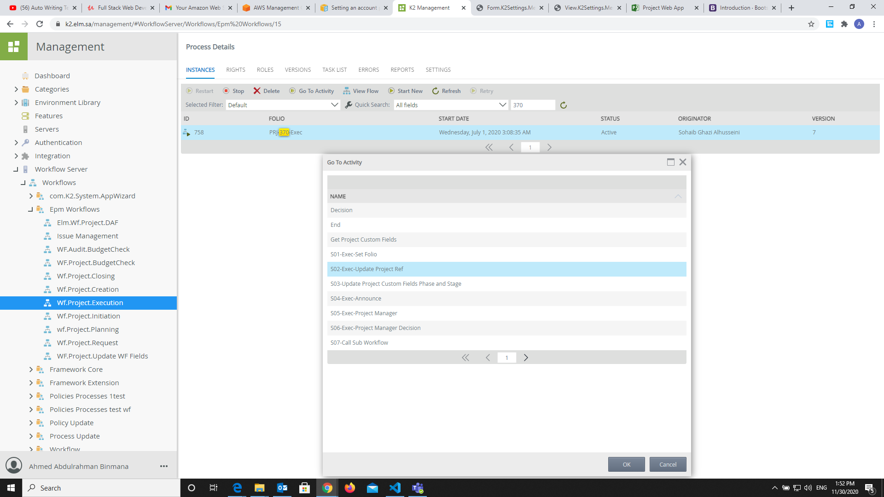
2
1
3
To update the Execution Workflow:
· Identify the Current Stage.
. Go To Activity.
. Search For “S02-Exec-Update Project Ref”
. Then Click Ok.
4

Slide 30
How to grant Access for corporate dashboard and KPI

Slide 31
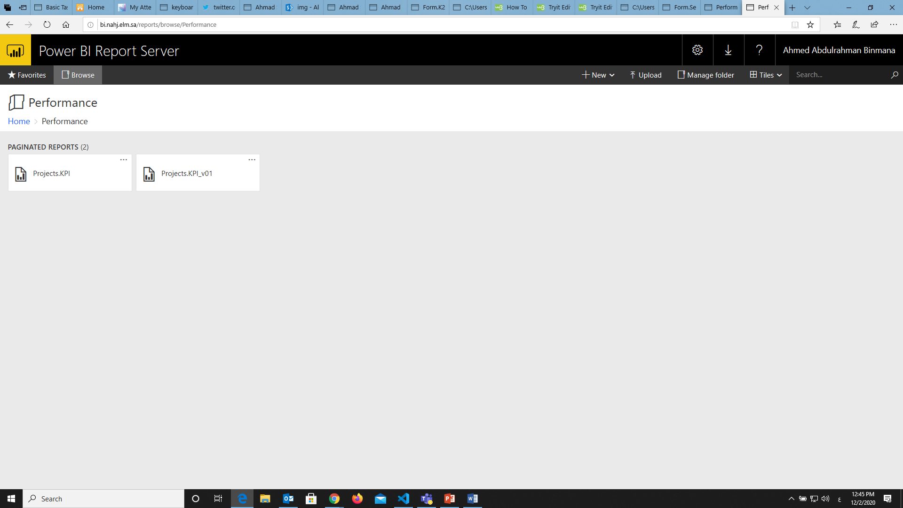
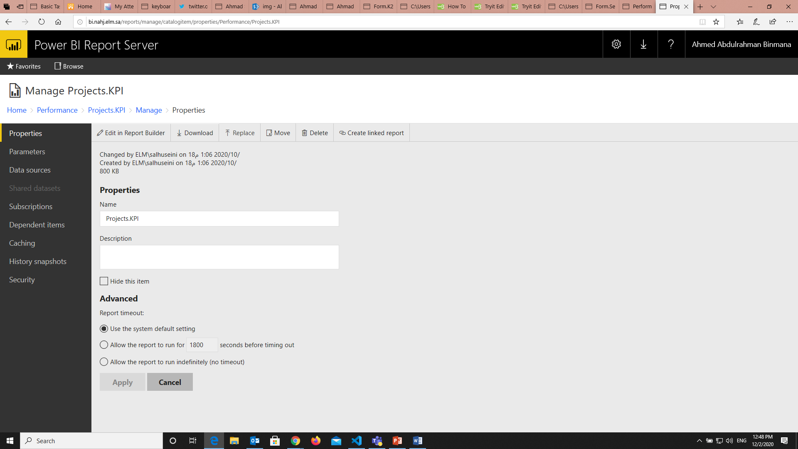
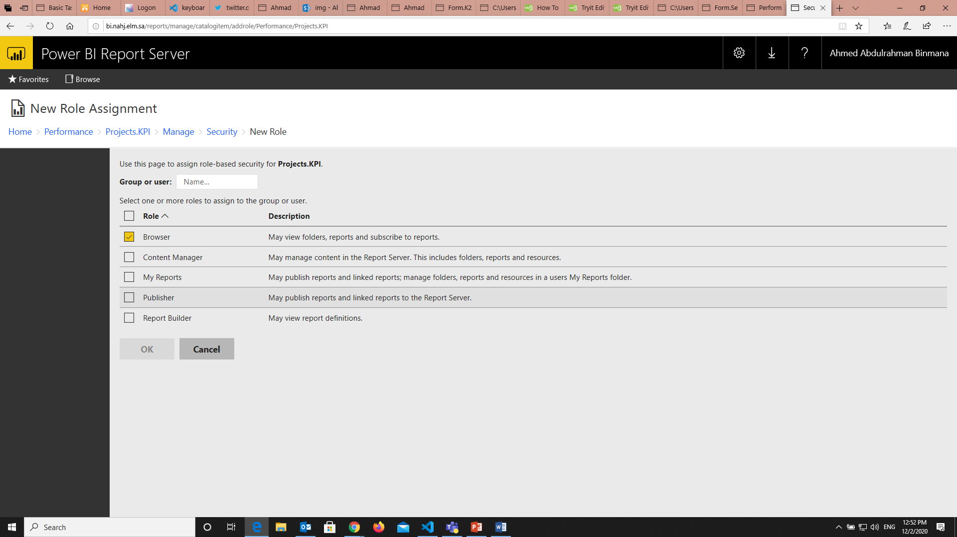
How to grant Access for corporate dashboard and KPI:
To grant access to the corporate dashboard and KPI:
You have to receive an email to give an access to the authorized user.
Go To http://bi.nahj.elm.sa/reports.
Then go to Performance folder.
You will have three dots on the top of the card.
Click on it, then click on manage.
After that you have to click on security on the left bottom.
If you navigate to security section, you will have “Add group or user”.
Then click on it, and you have to write like this “ elm\abinmana “
Before you click ok, you have to check the “ Browser”.

Slide 32


Slide 33
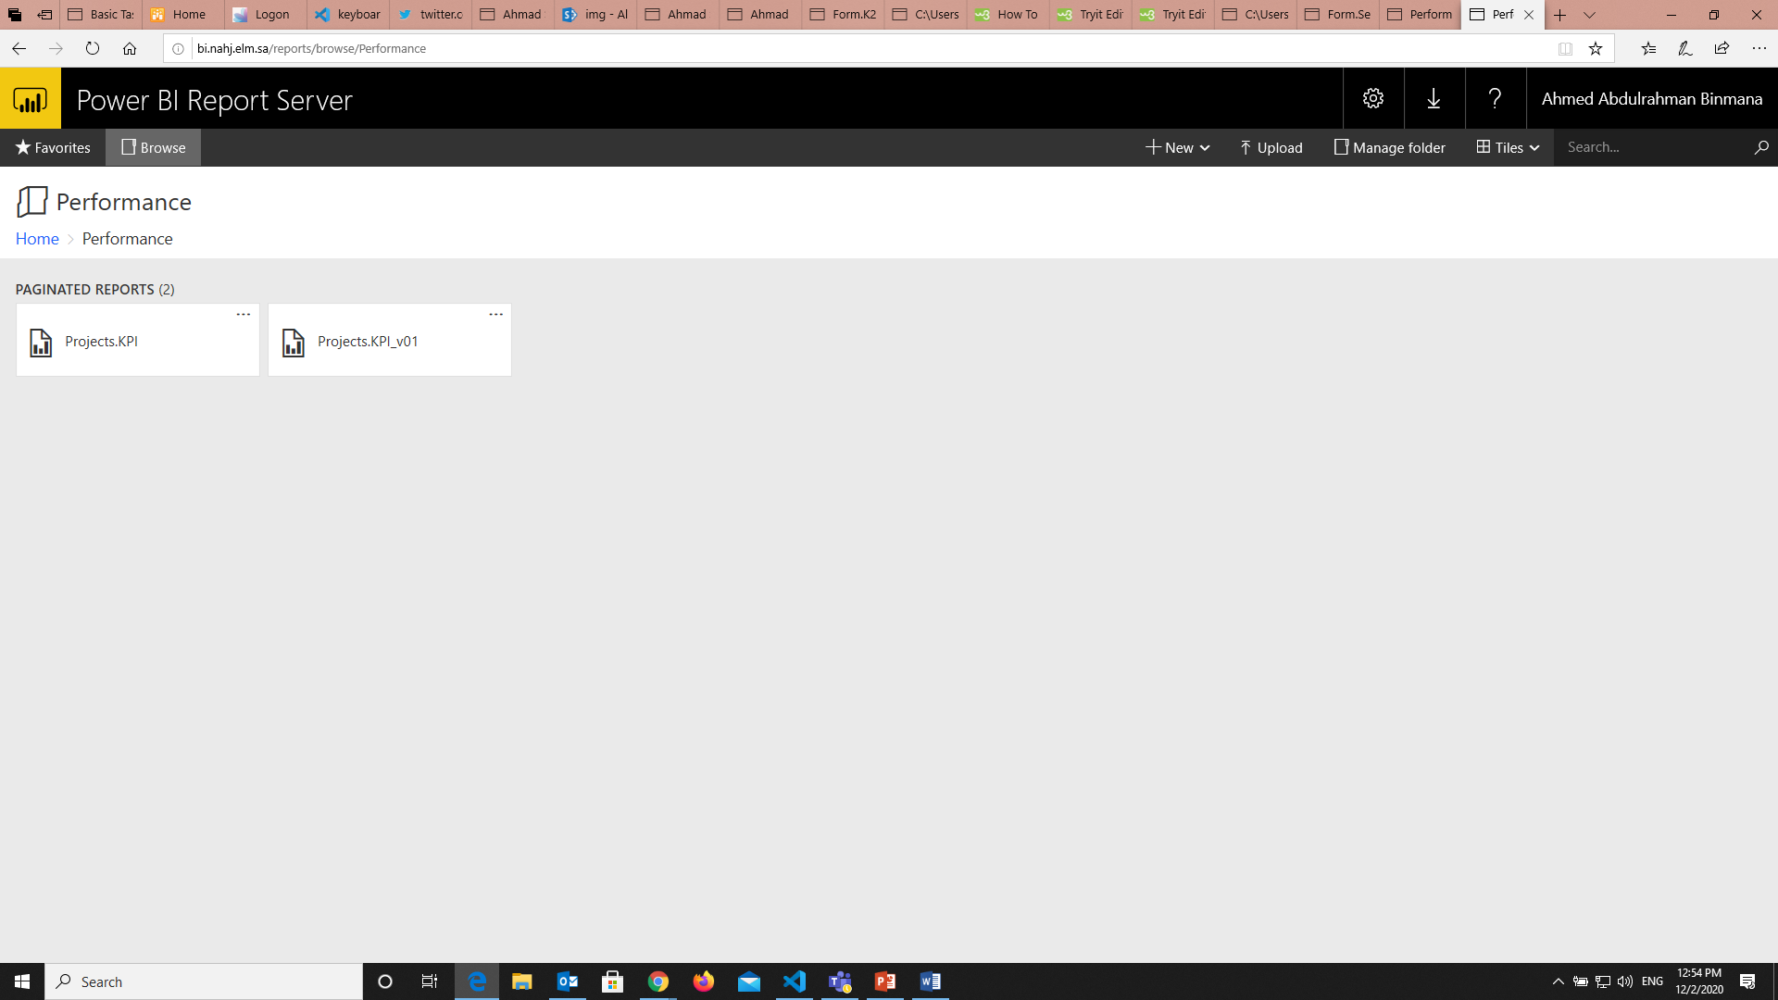

Slide 34
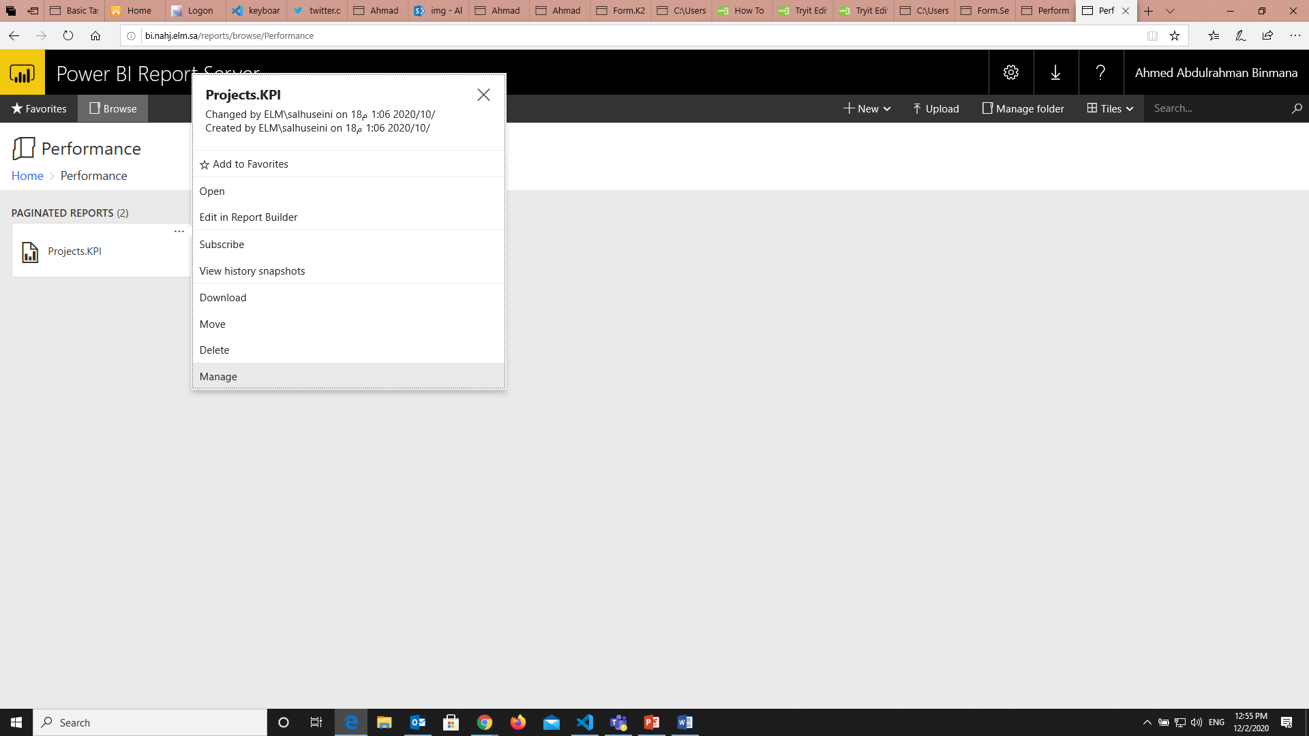

Slide 35


Slide 36
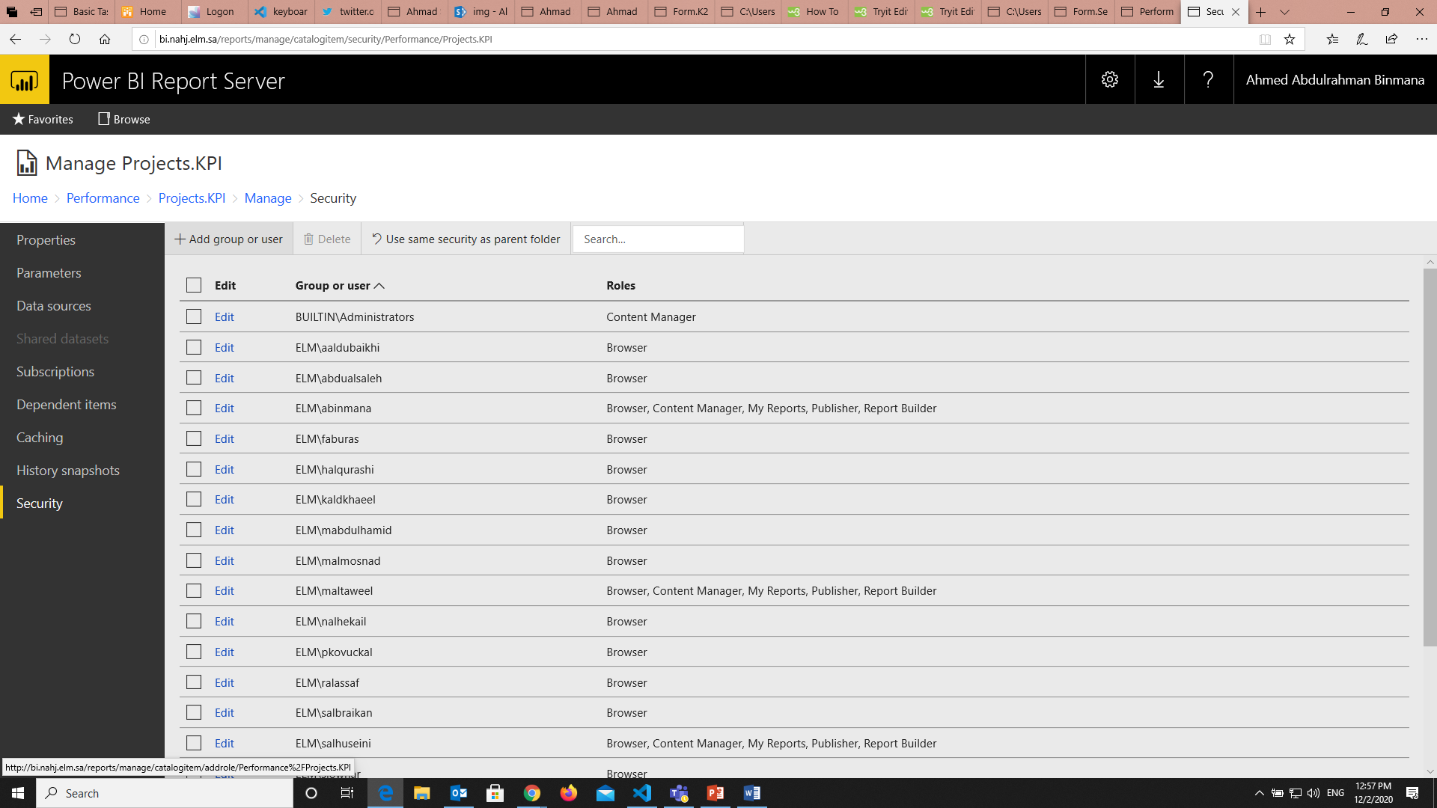

Slide 37
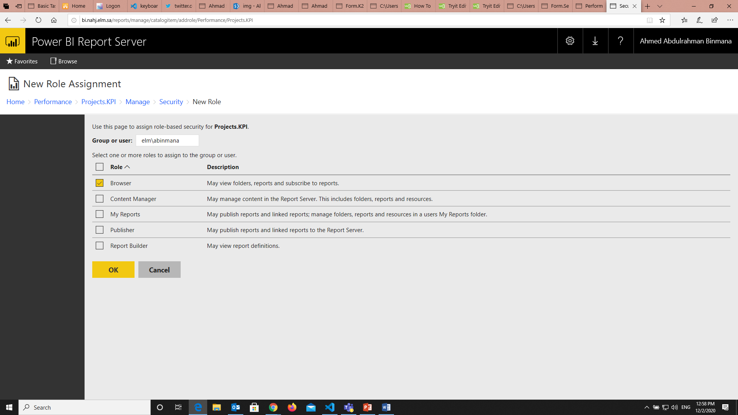

Slide 38
Change Workflow Ownership

Slide 39
Change Workflow Ownership
How to move ownership from project manager to another:
You have to receive an email to move the ownership .
Go To https://nahj.elm.sa/PWA/default.aspx

Slide 40
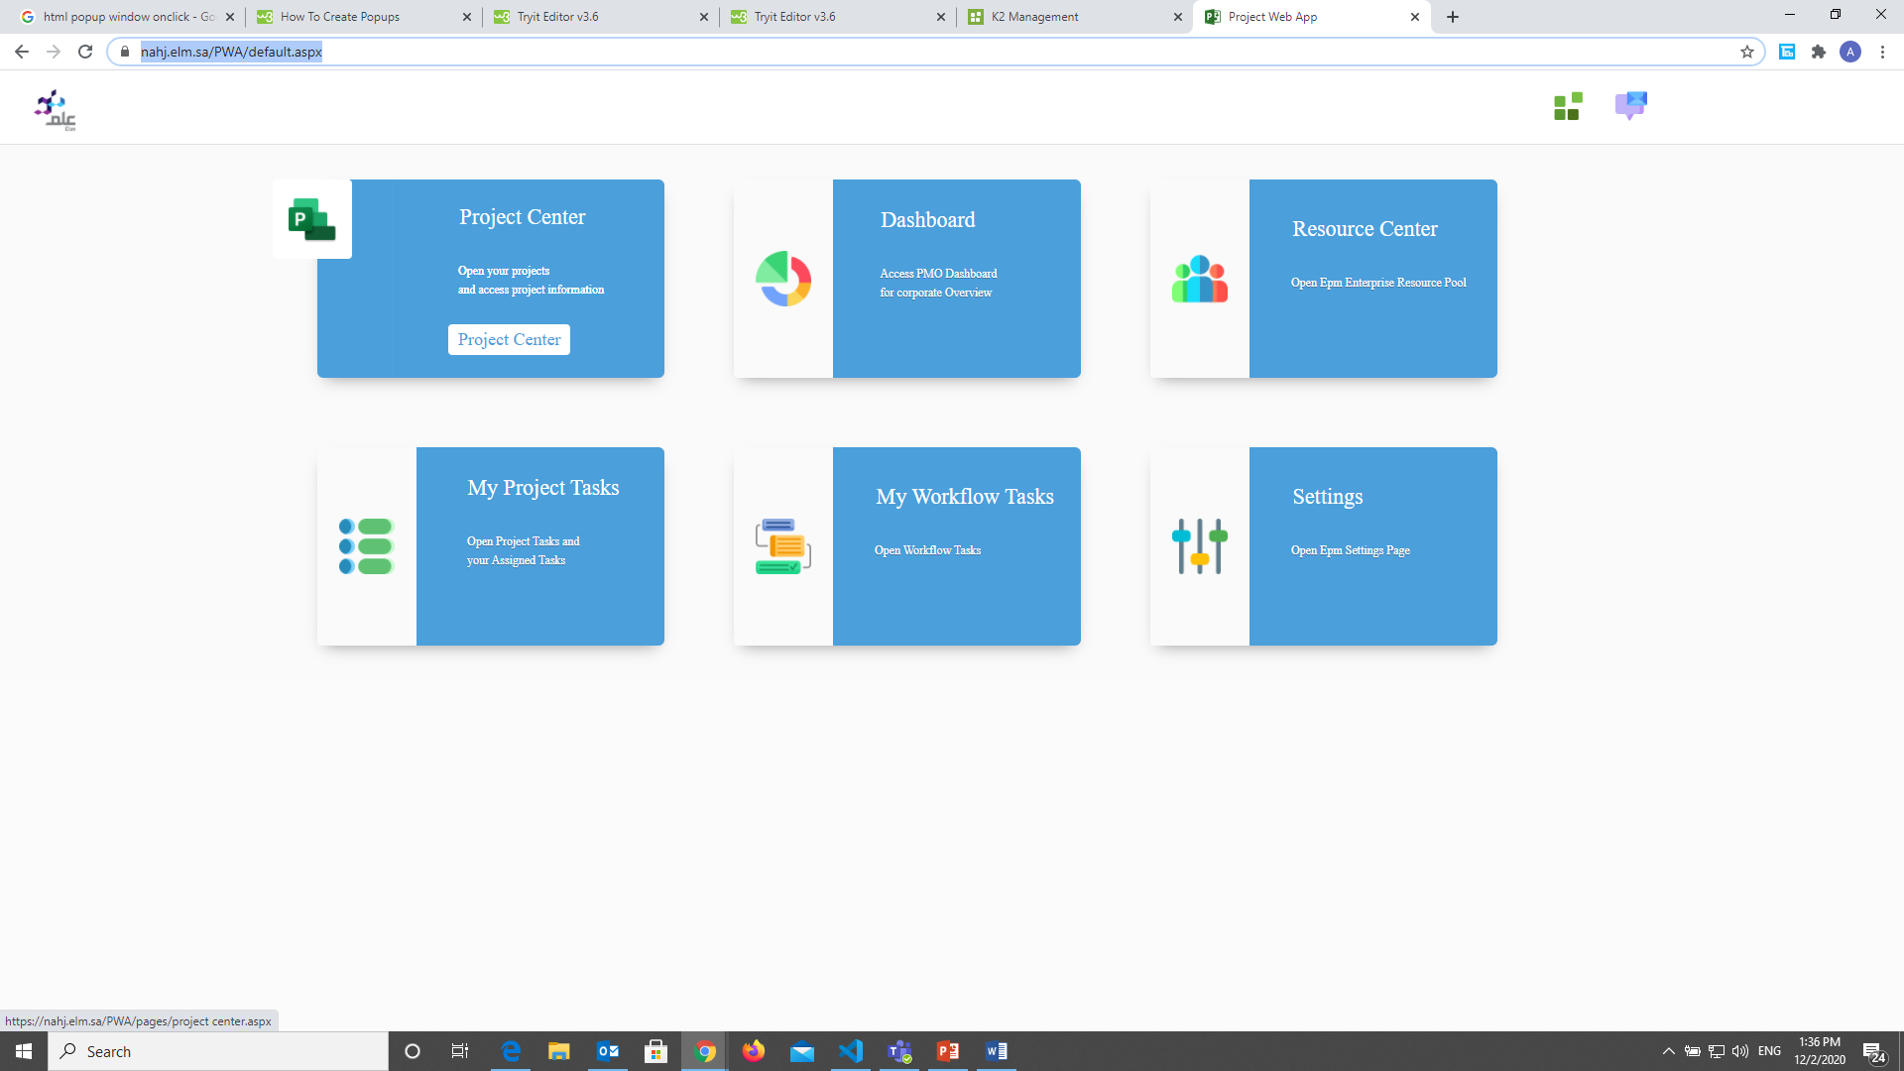

Slide 41
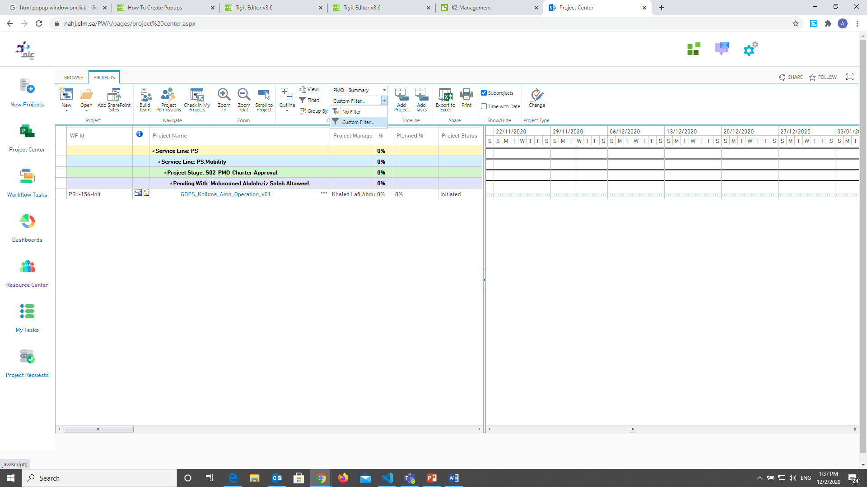

Slide 42
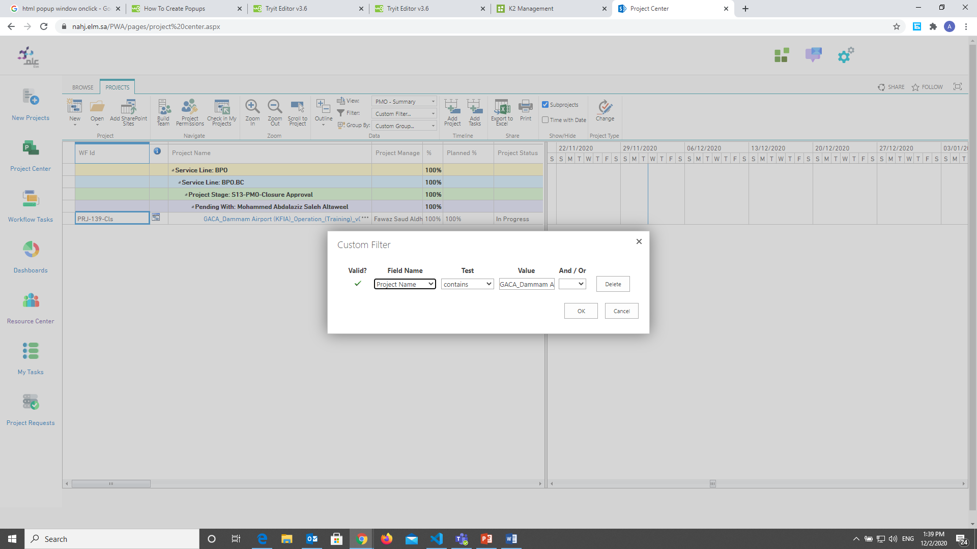

Slide 43
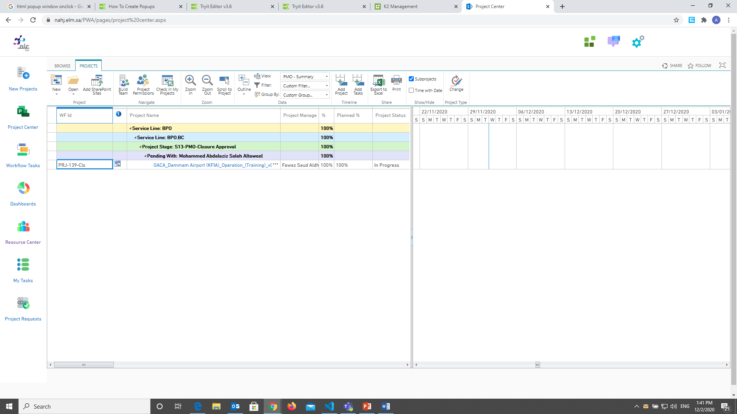
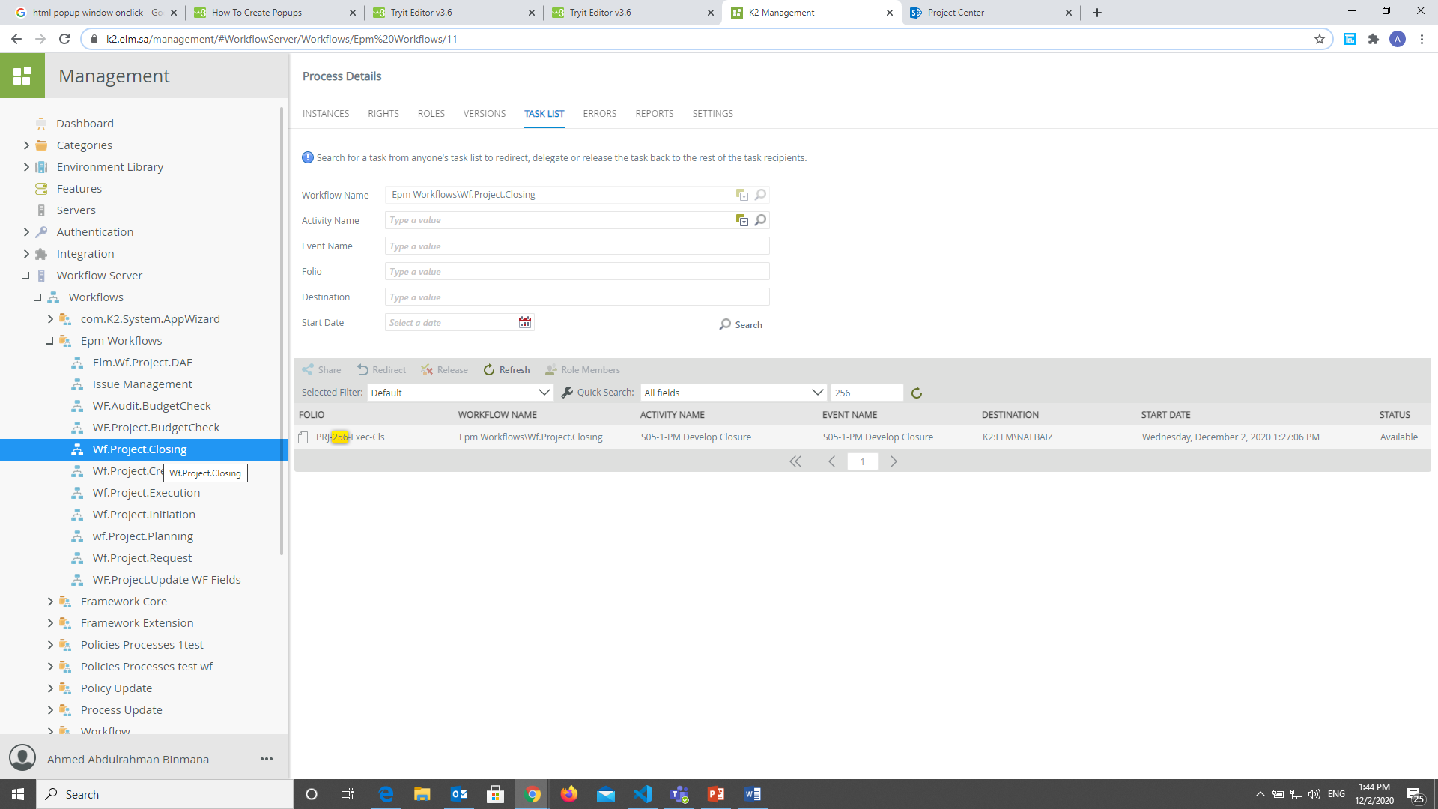
You have to take the WF Id number then move
to K2 management with same phase https://k2.elm.sa/management/
We will go to closing phase,
because the project in closing phase

Slide 45
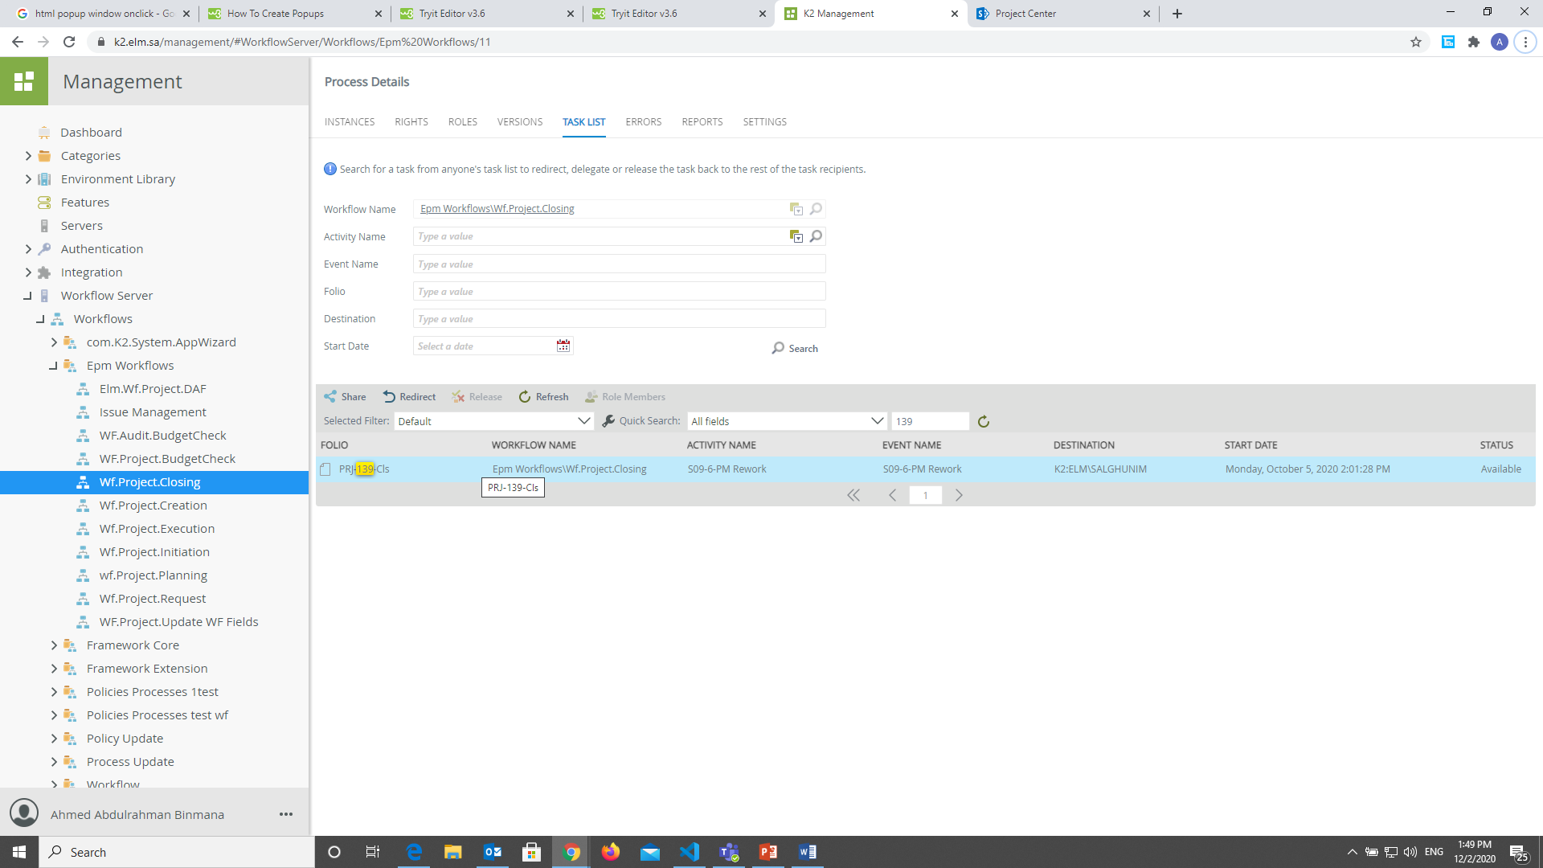
You have to click on it, then click on ‘ Redirect ’

Slide 46
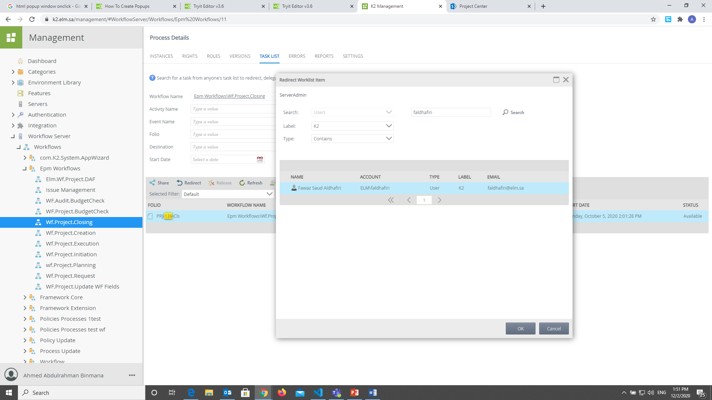

Slide 47
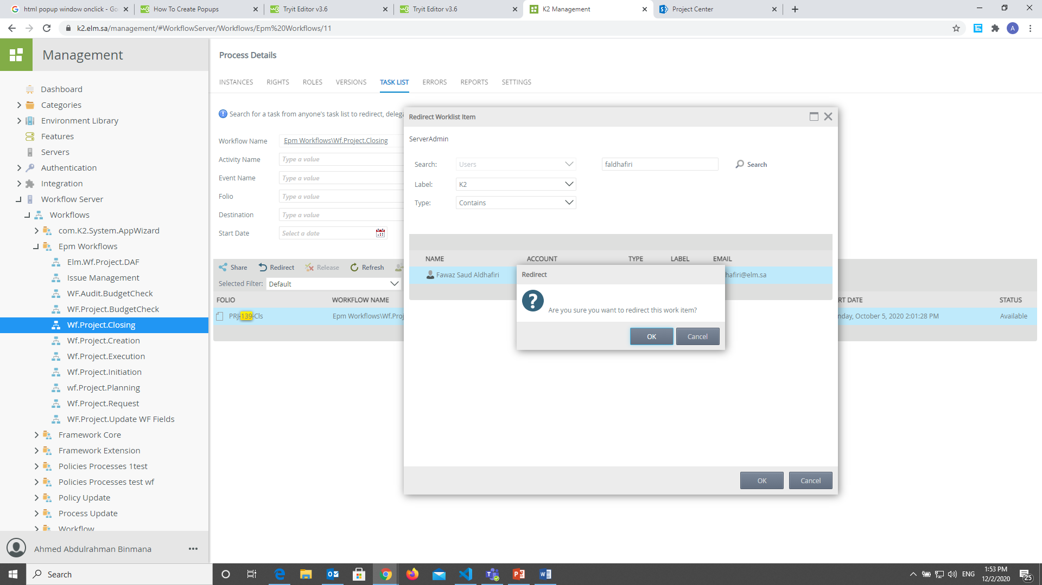

Slide 48
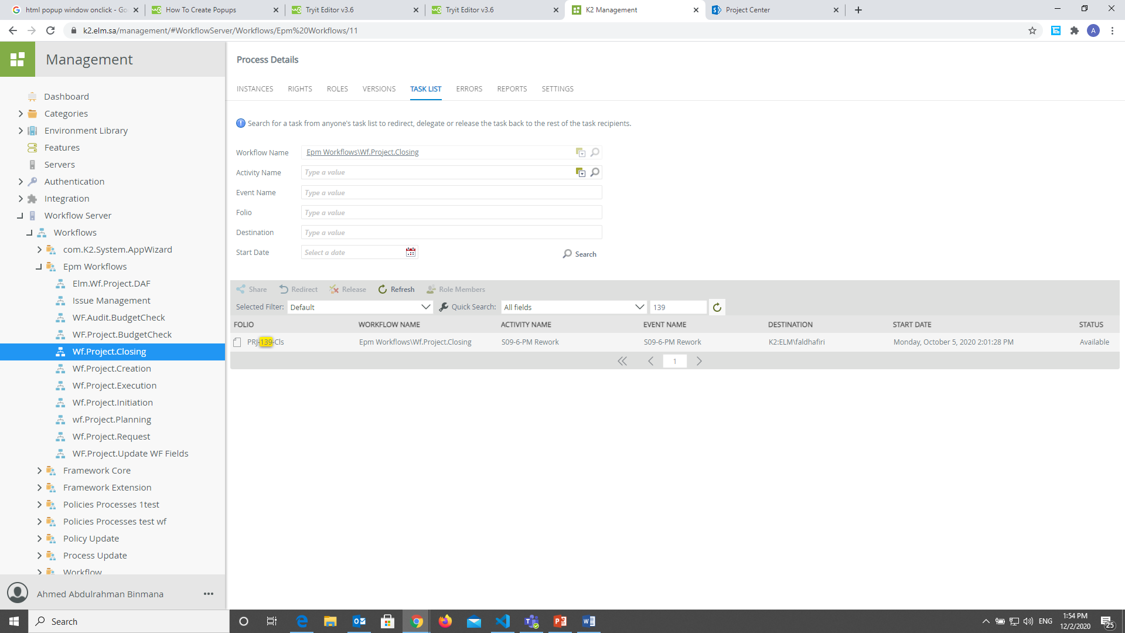
Now you can see it moved to the now ownership.

Slide 49
The approval button not exist

Slide 50
How to solve this issue.
You have to open the k2 designer.
https://k2.elm.sa/designer
You have to know where the issue, in any form? And you have to fix it.

Slide 51
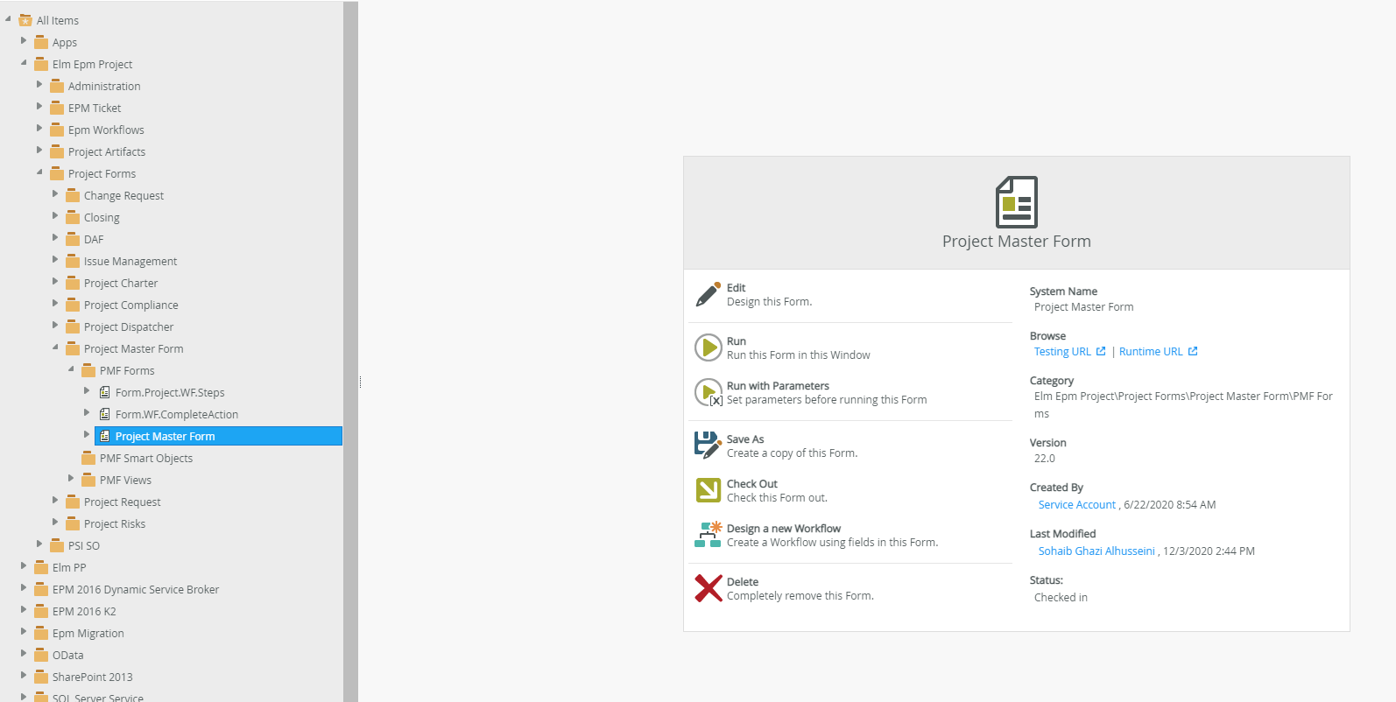

Slide 52
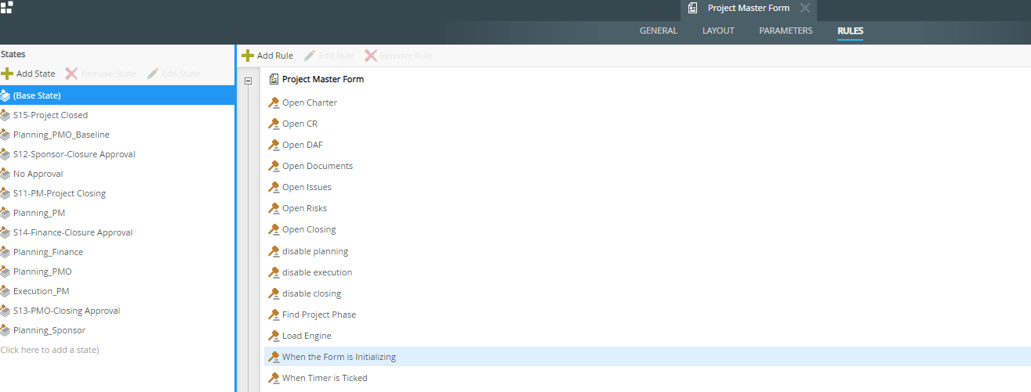

Slide 53
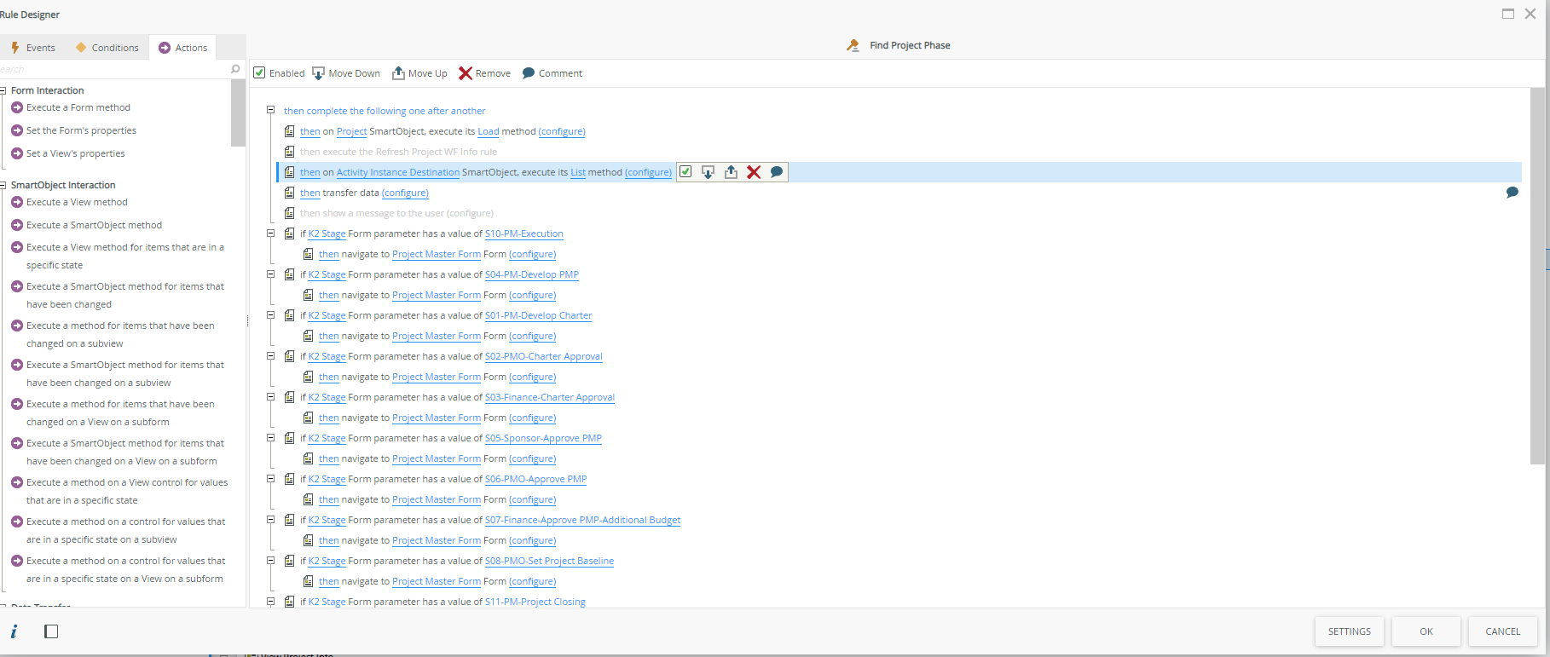

Slide 54
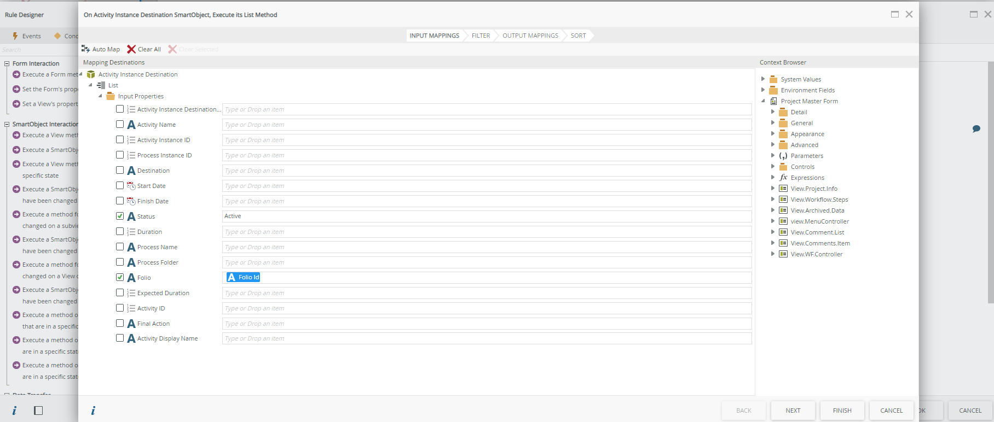

Slide 55
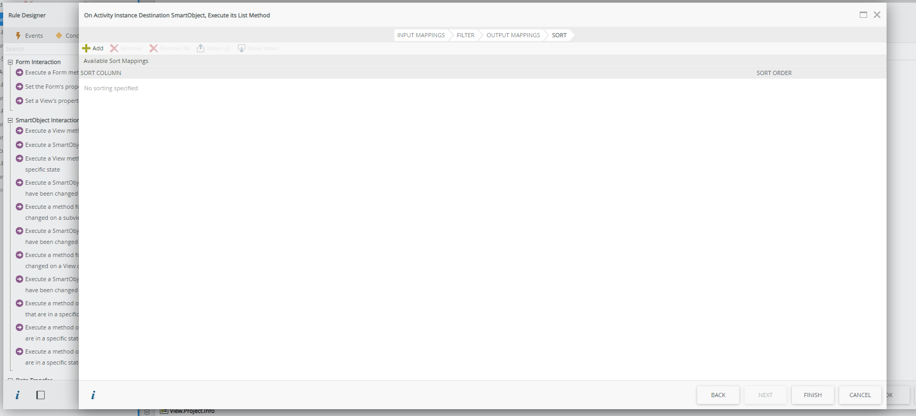

Slide 56
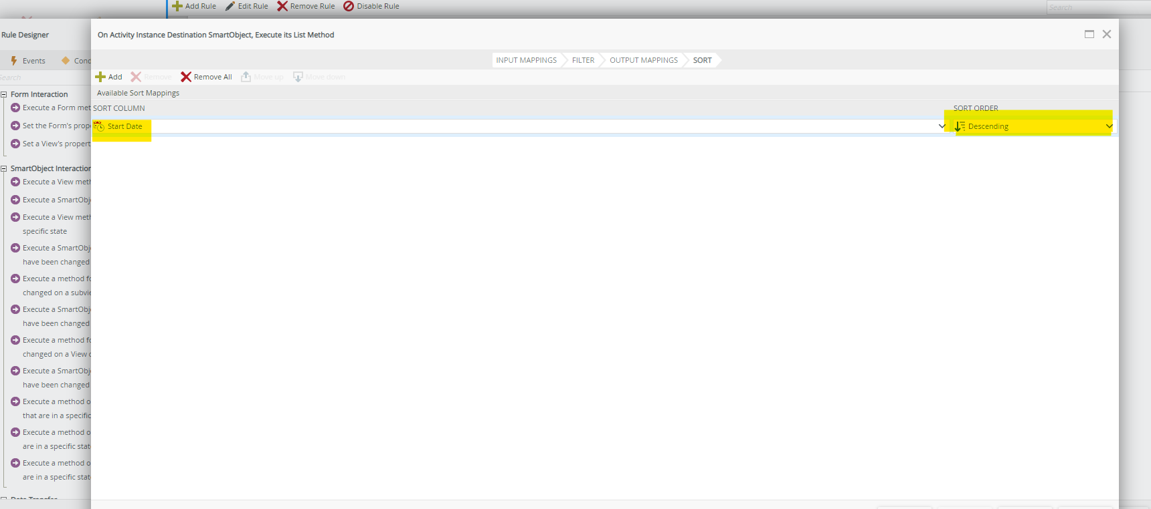

Slide 57
How to Create Sub-WBS a Code in SAP

Slide 58
Code Structure
Project Type | SAP ID | Project Summary WBS | Description
Internal | IP-XX-1000001 e.g. IP-ES-1000009 | IP-XX-1000001-01 e.g. IP-ES-1000009-01 | XX : Department Shortcut
External | EP-XX-1000001 e.g. EP-TS-1000007 | EP-XX-1000001-01 e.g. EP-TS-1000007-01 | XX : Department Shortcut
Capital | CP-XX-1000001 e.g. CP-TS-1000011 | CP-XX-1000001-01 e.g. CP-TS-1000011-01 | XX : Department Shortcut
Program | PM-XX-YYYY e.g. PM-TS-RUHM | PM-XX-YYYY e.g. PM-TS-RUHM | XX : Department Shortcut YYYY: Program Short Code
Operation under program | PM-XX-YYYY e.g. PM-TS-RUHM | OP-XX-YYYY-### e.g. OP-TS-RUHM-001 | XX : Department Shortcut YYYY: Program Short Code ###: order number
Sub Project under a program | PM-XX-YYYY e.g. PM-TS-RUHM | PM-XX-YYYY-### e.g. PM-TS-RUHM-002 | XX : Department Shortcut YYYY: Program Short Code ###: order number
Product | PD-XXXX e.g. PD-ZAWL | PD-XXXX-01 e.g. PD-ZAWL-01 | XXXX: Product Shortcut 01: is Fixed
Product Enhancement | PD-XXXX e.g. PD-ZAWL | PD-XXXX-1# e.g. PD-ZAWL-13 | XXXX: Product Shortcut 1#: Greater than 10 for all enhancements

Slide 59
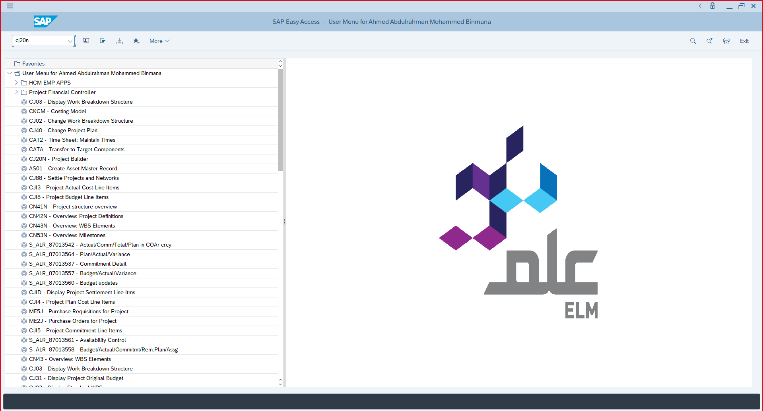

Slide 60
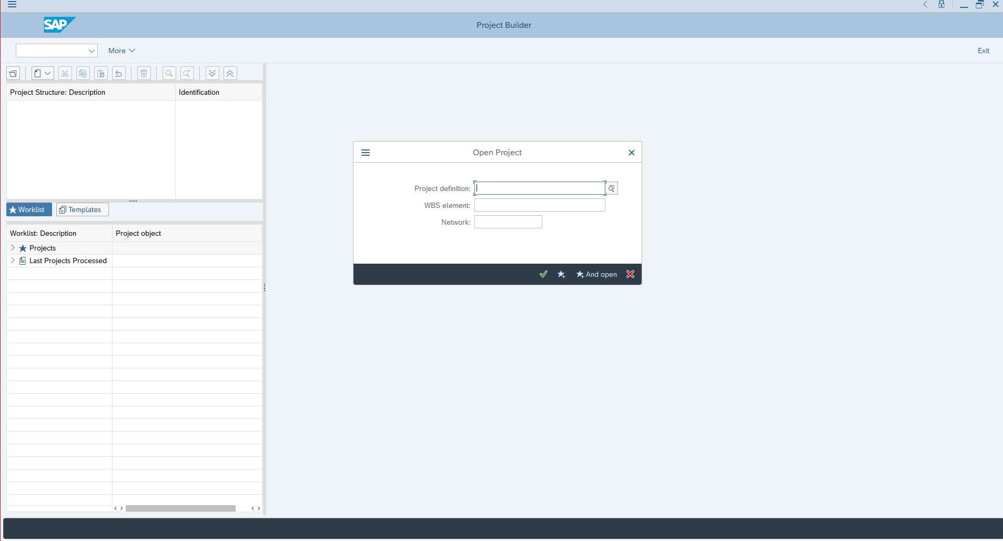
Here you have to get a ‘SAP ID’ from Project Center

Slide 61
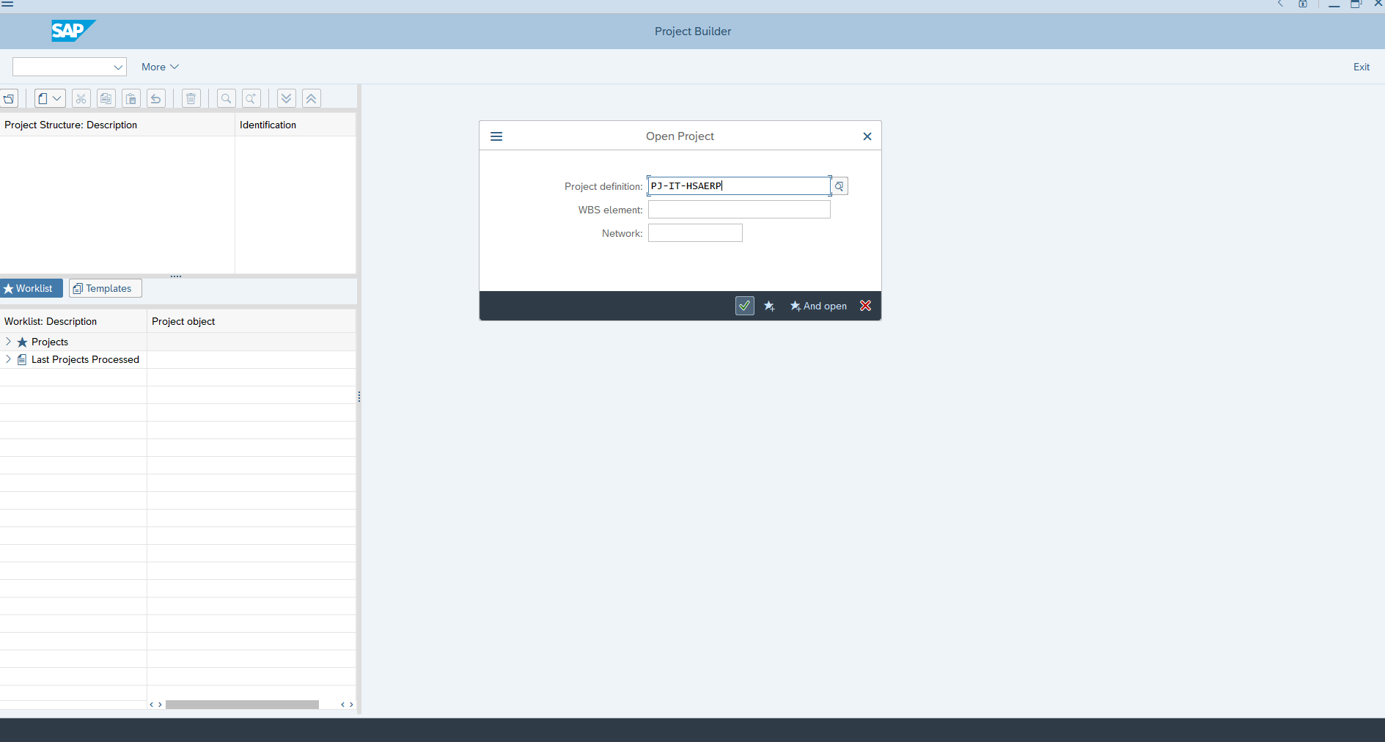
Then Click Here

Slide 62
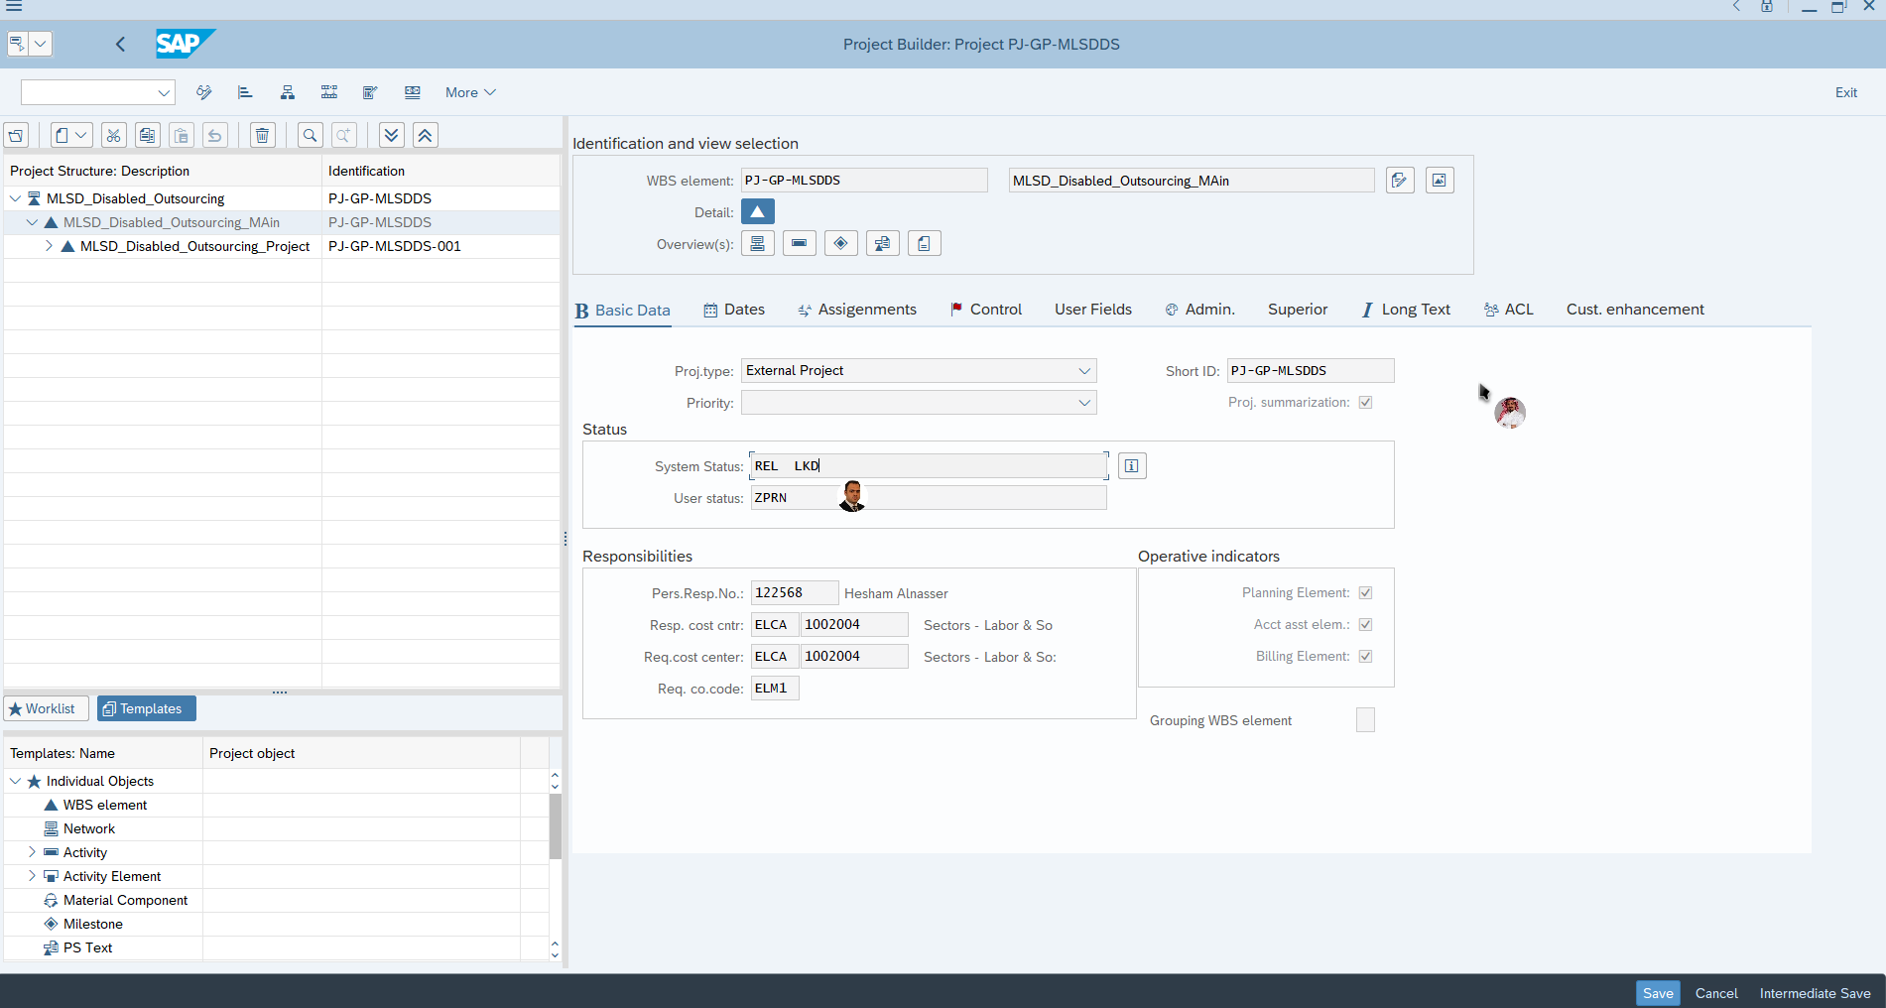
LKD means its locked
And you have to unlock it

Slide 63
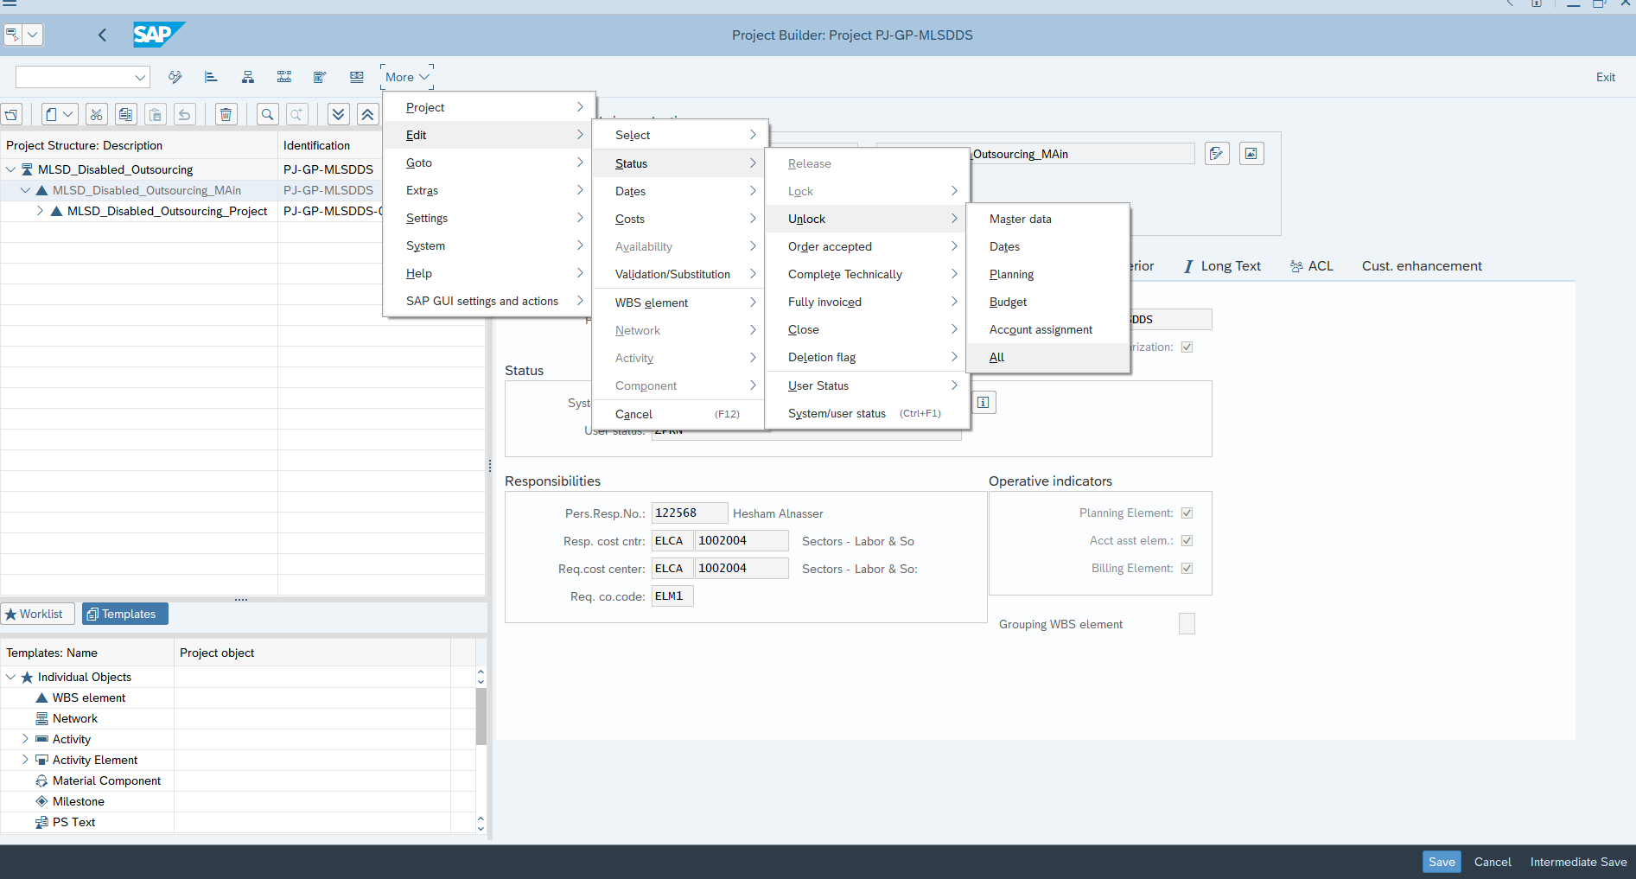
Here how to unlock the code

Slide 64
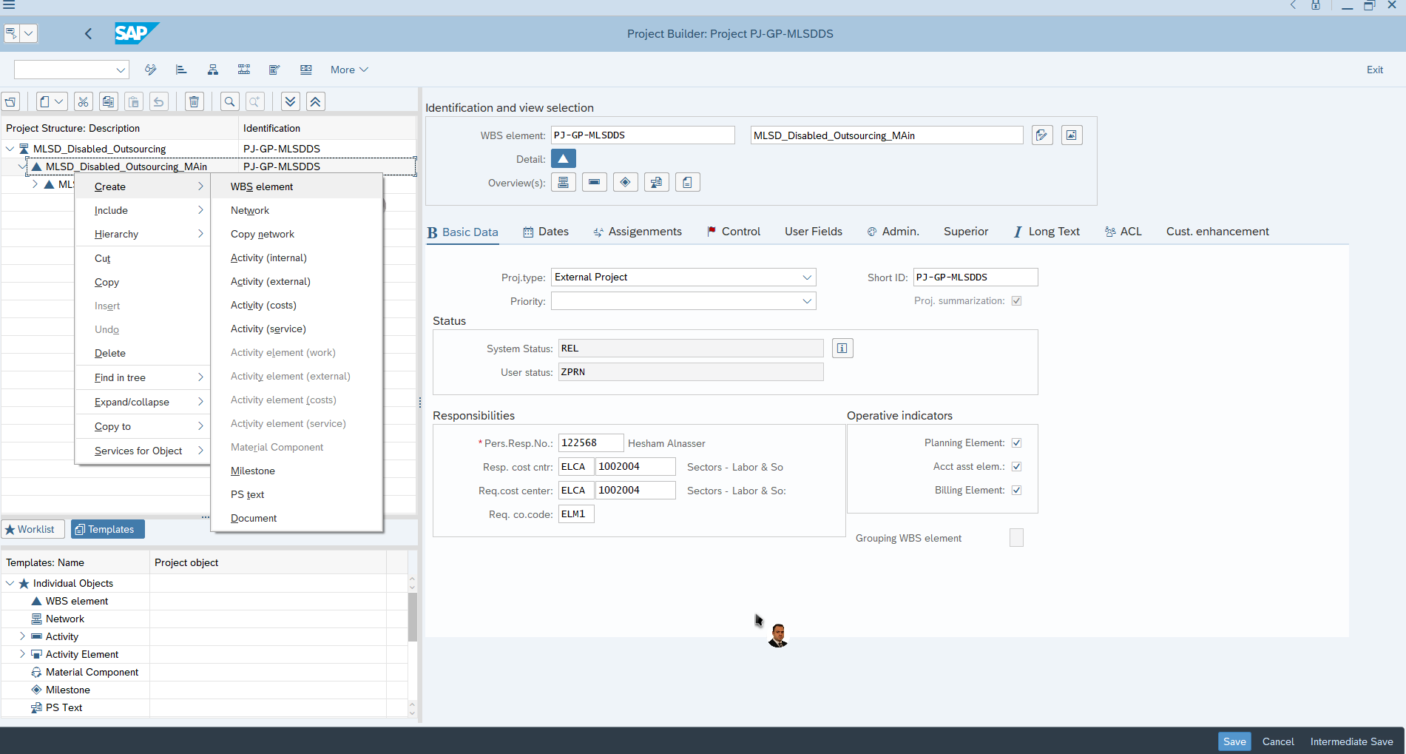
Right
Click

Slide 65
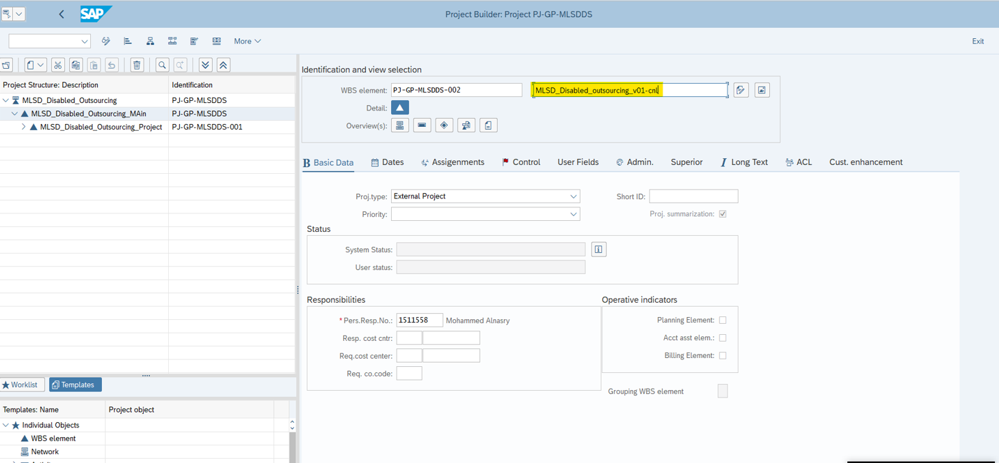
Here you have name the sub-code

Slide 66


Slide 67


Slide 68

Here you will assign the responsible person for the sub-code

